Slide 1
30X DNMs - Run 6

Slide 2
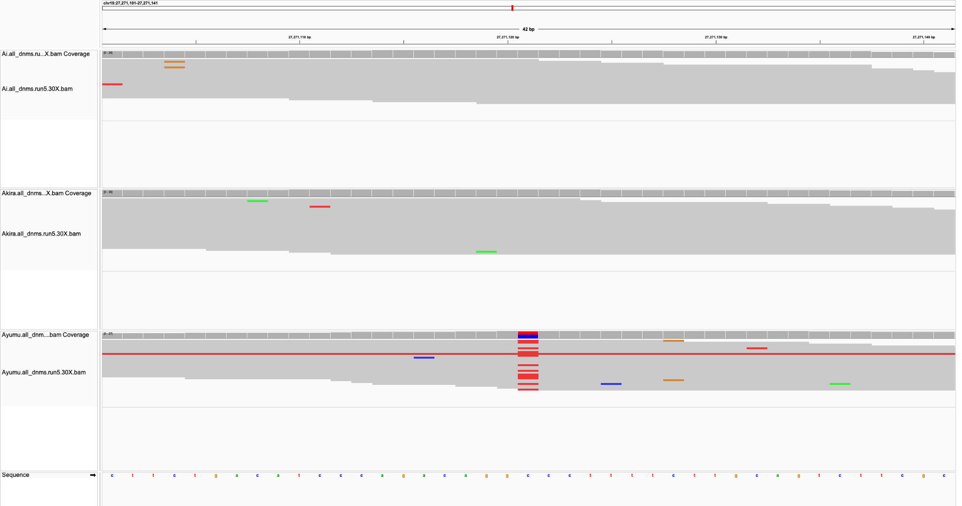
Sire
Dam
Child

Slide 3
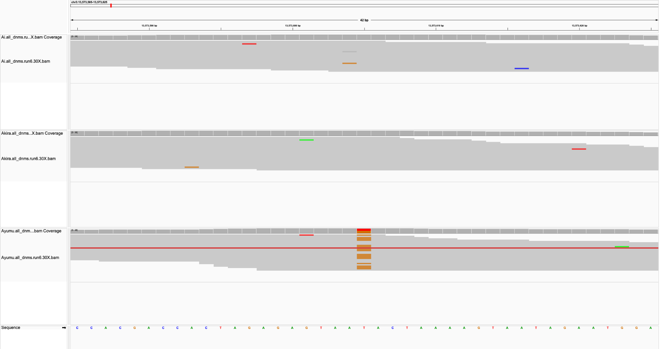
Sire
Dam
Child

Slide 4
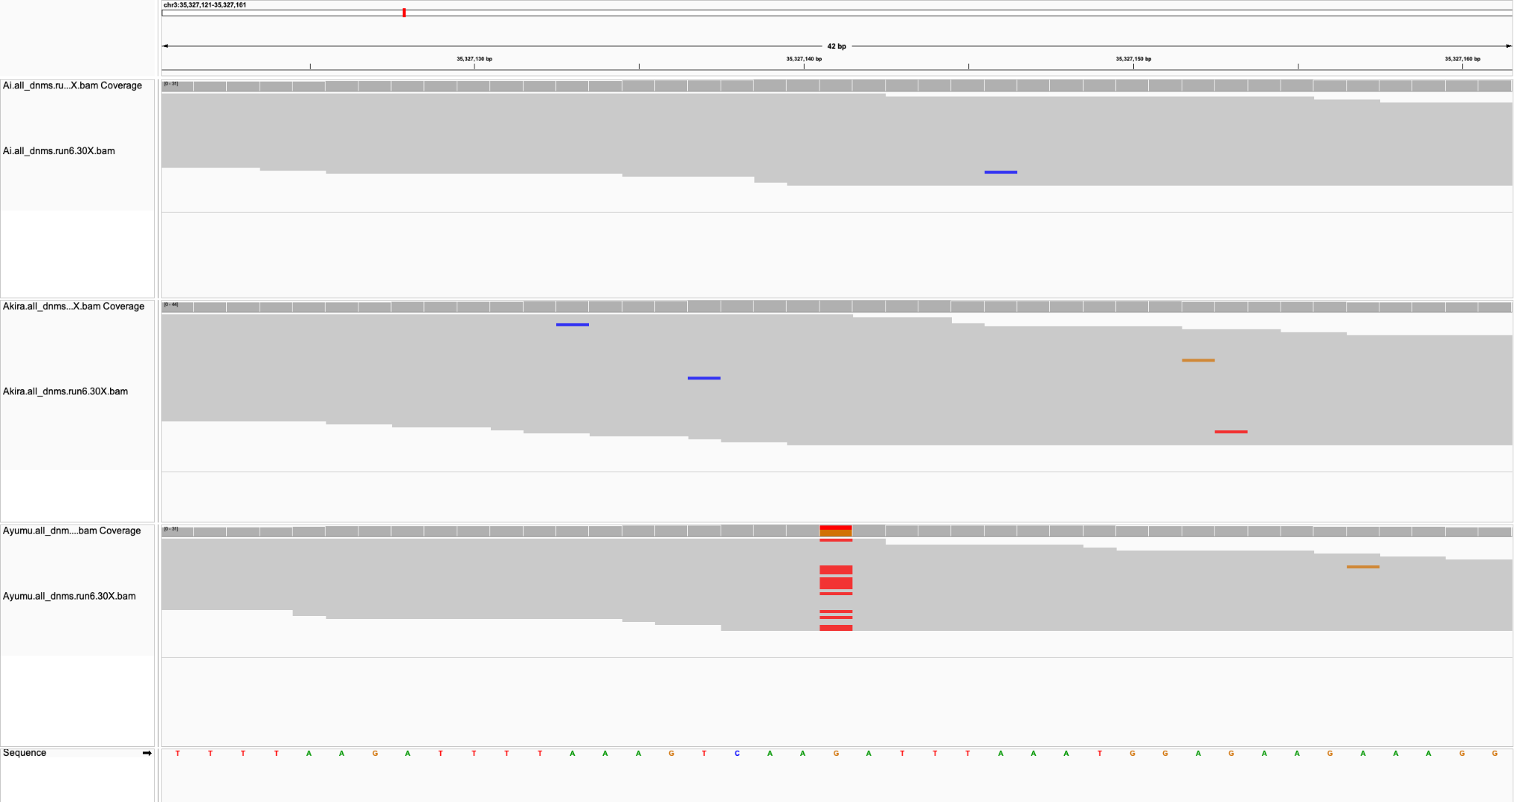
Sire
Dam
Child

Slide 5
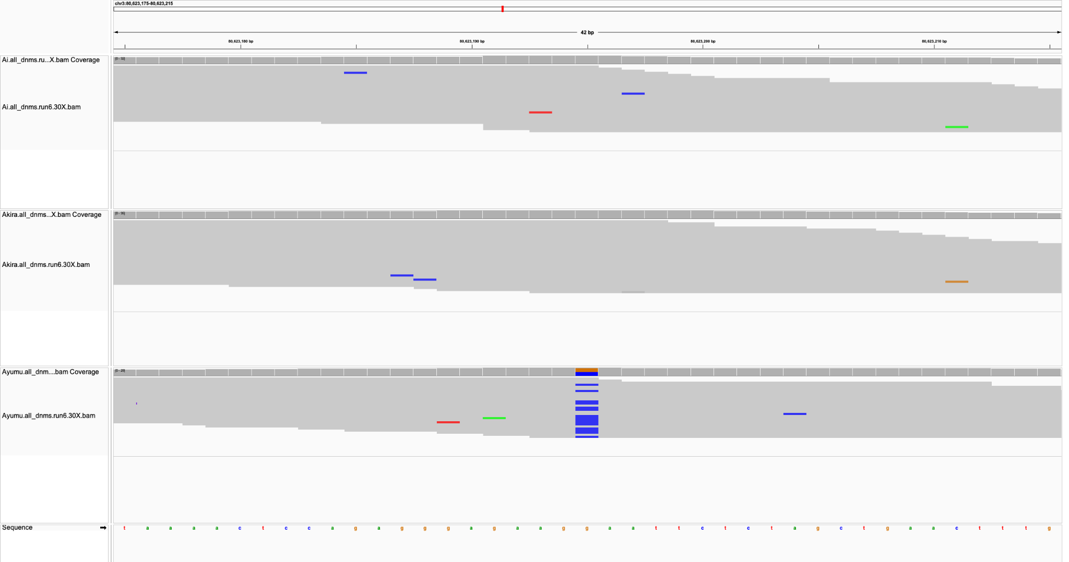
Sire
Dam
Child

Slide 6
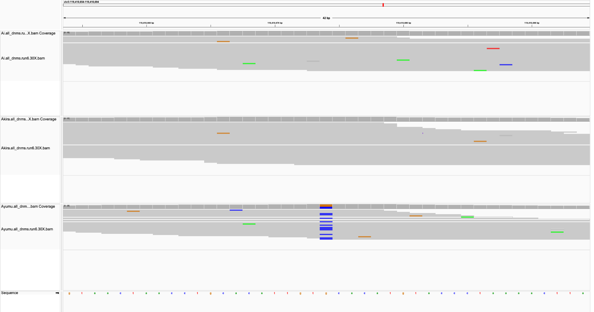
Sire
Dam
Child

Slide 7
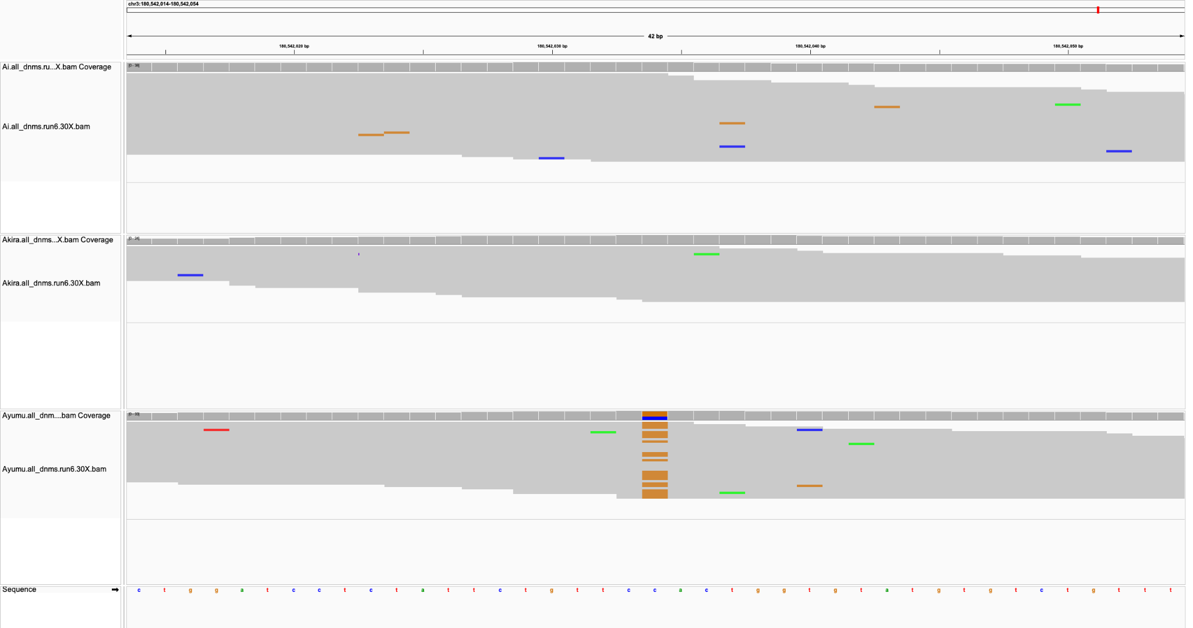
Sire
Dam
Child

Slide 8
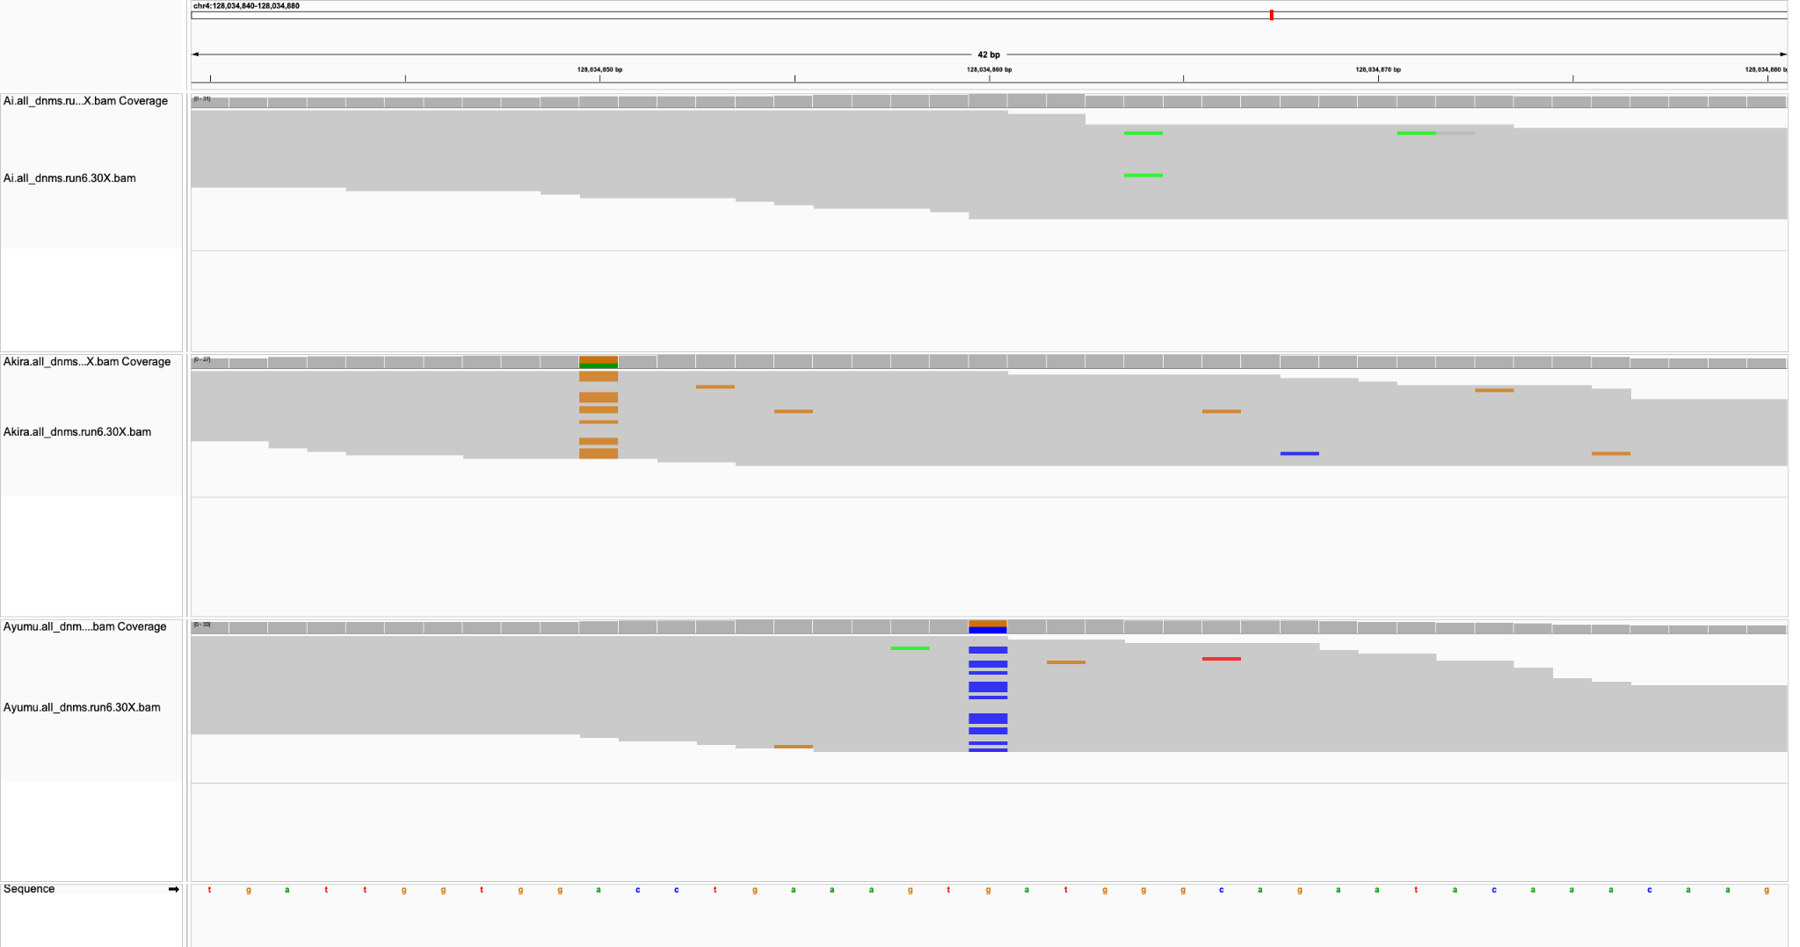
Sire
Dam
Child

Slide 9
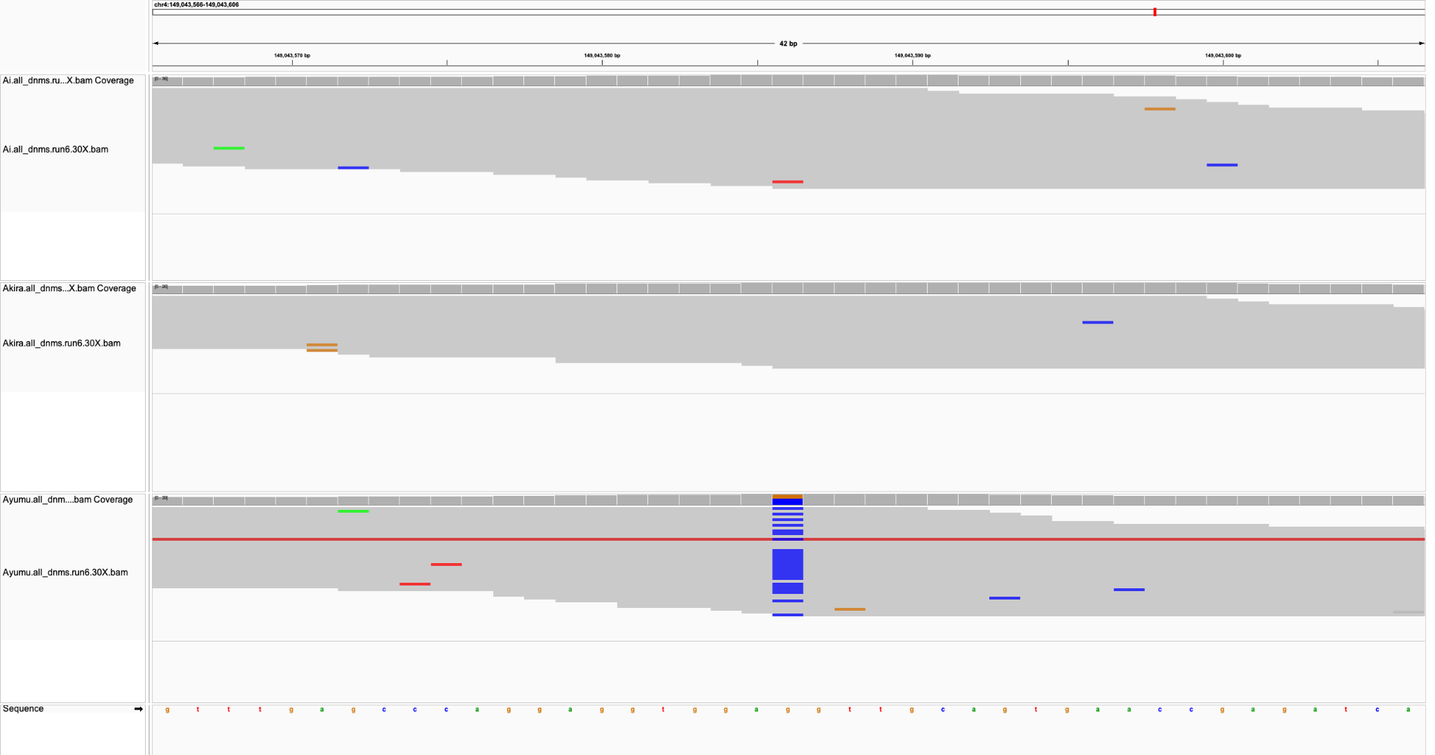
Sire
Dam
Child

Slide 10
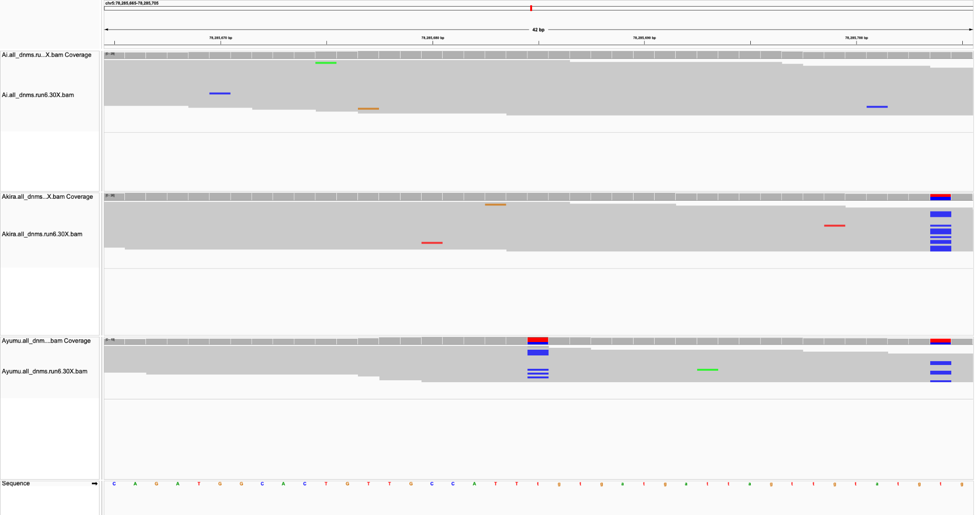
Sire
Dam
Child

Slide 11
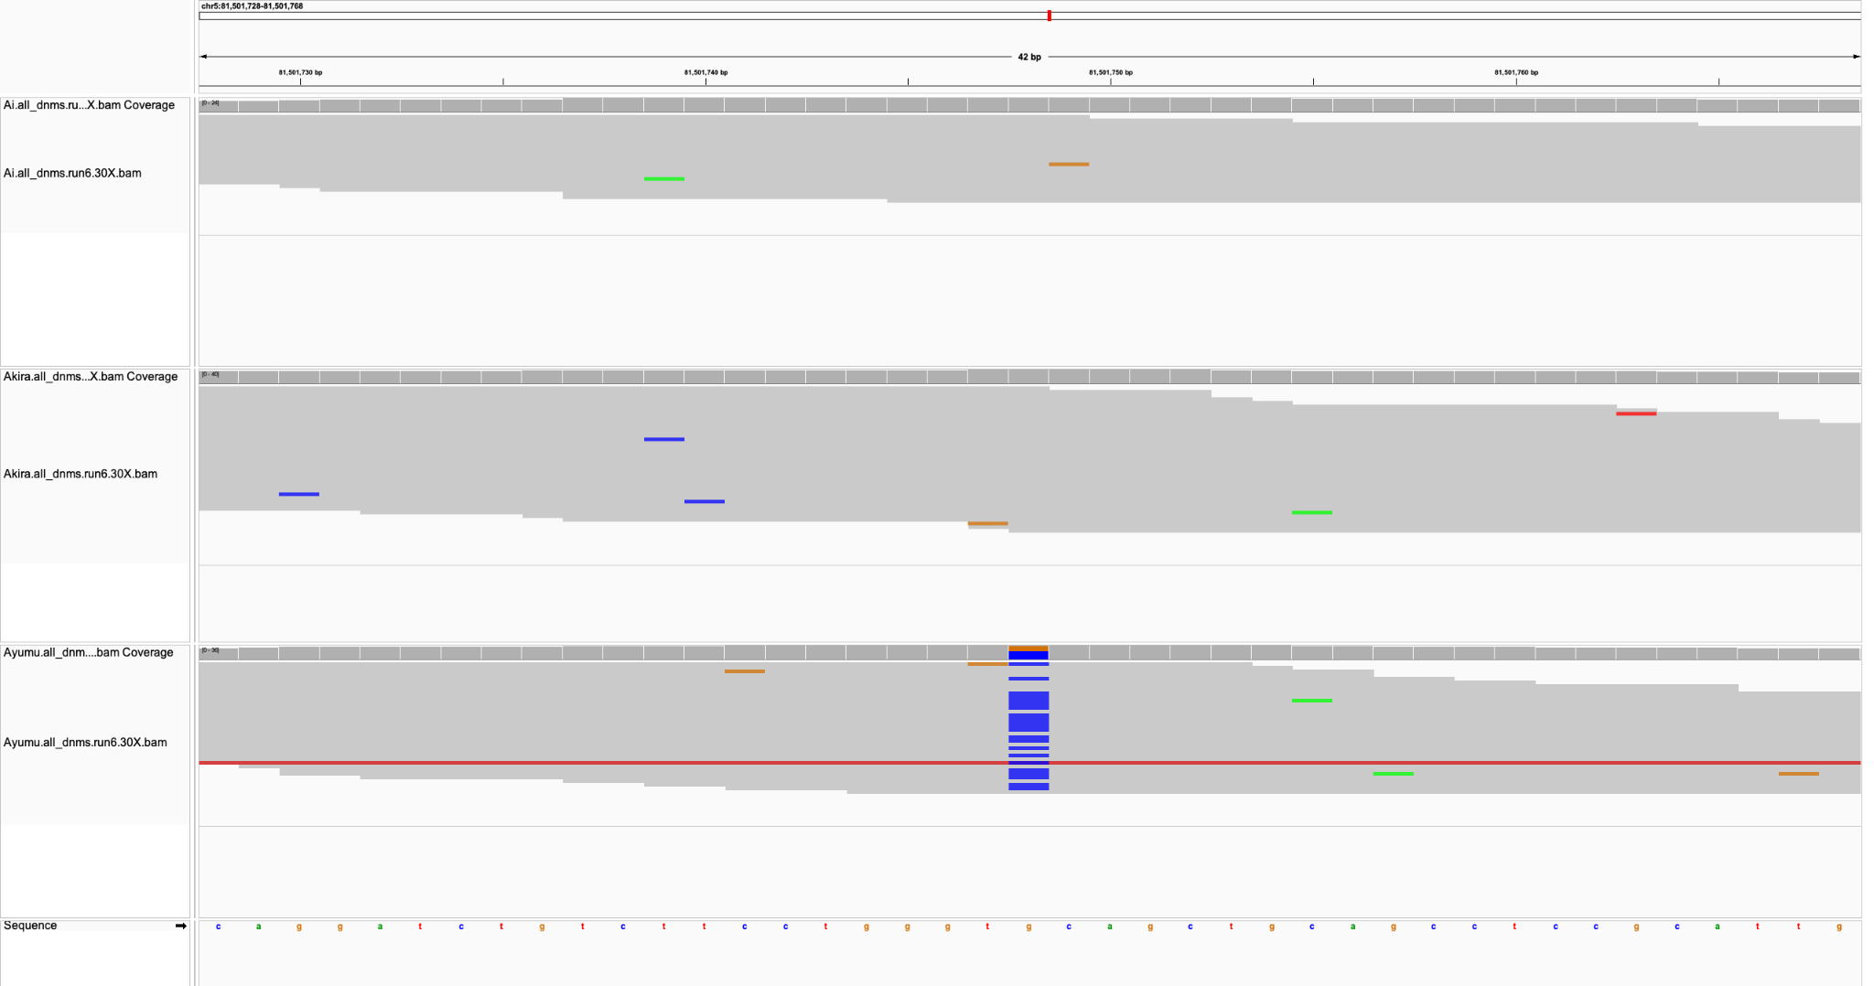
Sire
Dam
Child

Slide 12
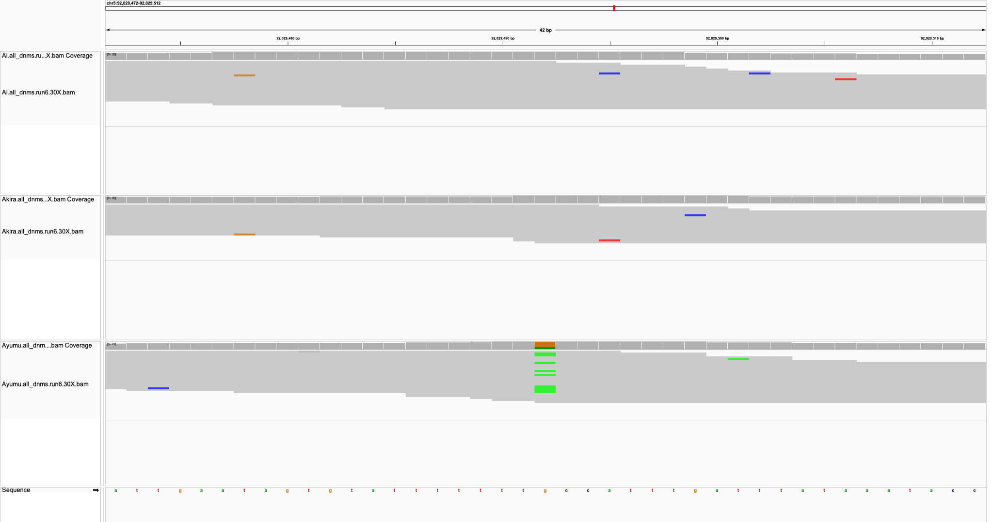
Sire
Dam
Child

Slide 13
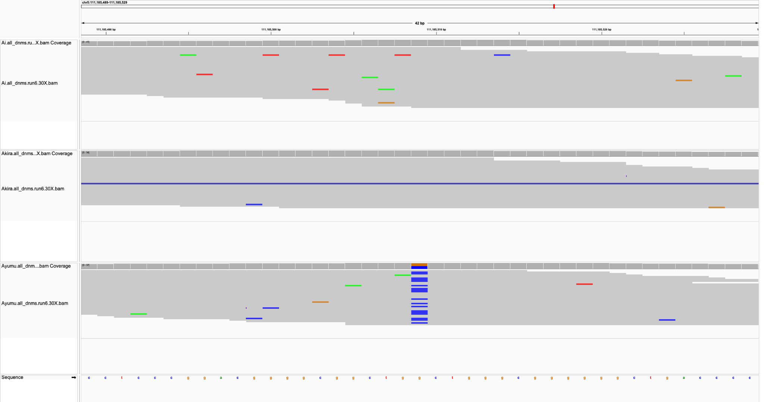
Sire
Dam
Child

Slide 14
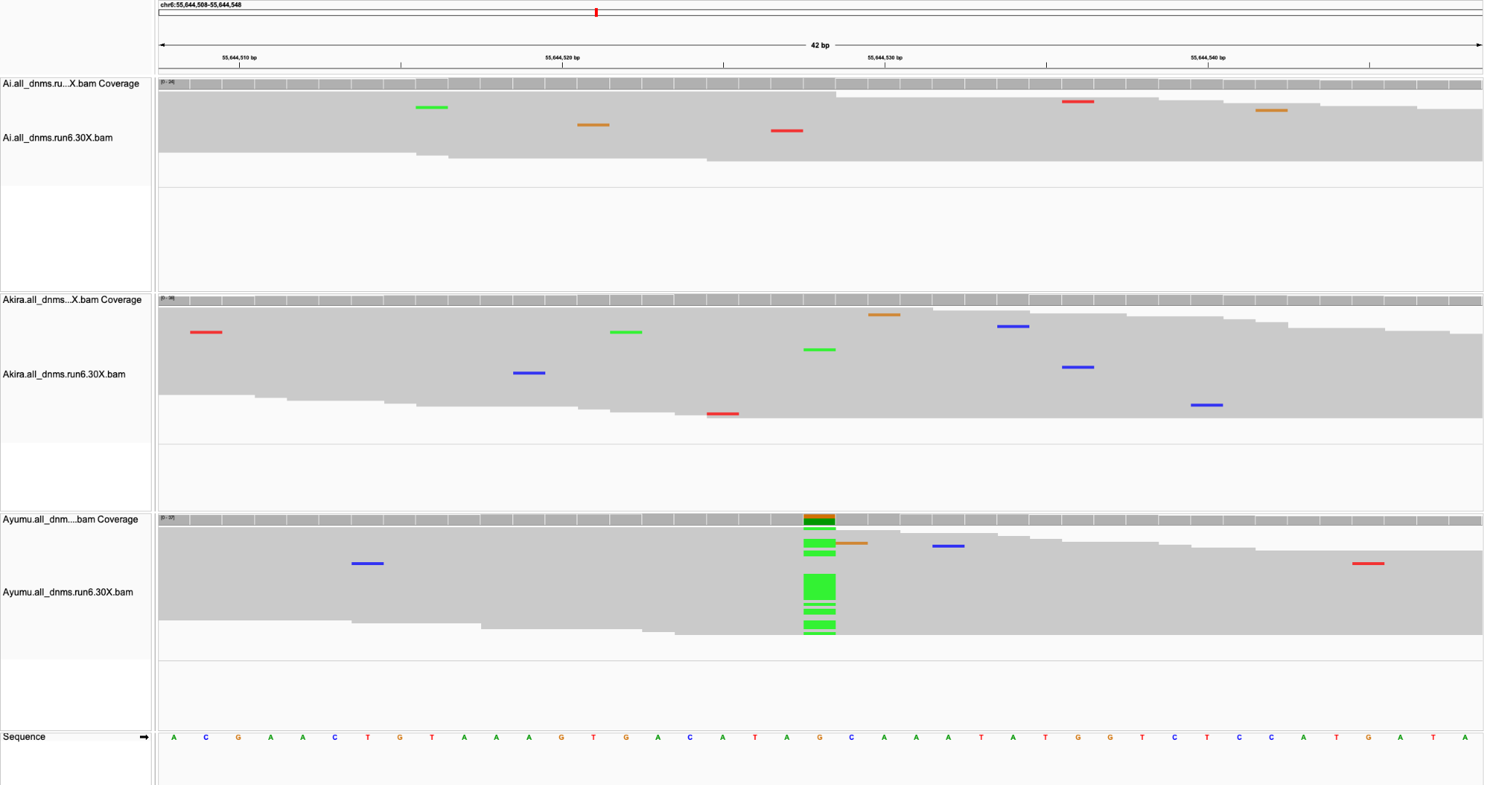
Sire
Dam
Child

Slide 15
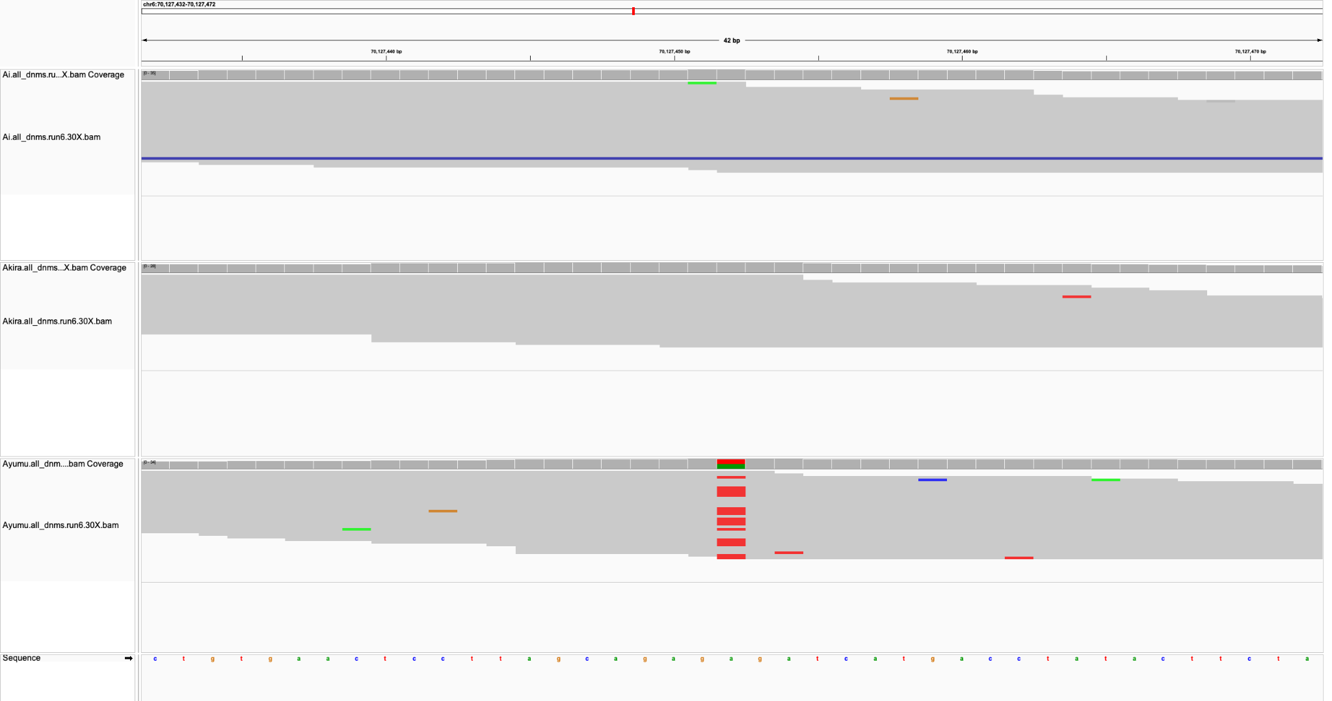
Sire
Dam
Child

Slide 16
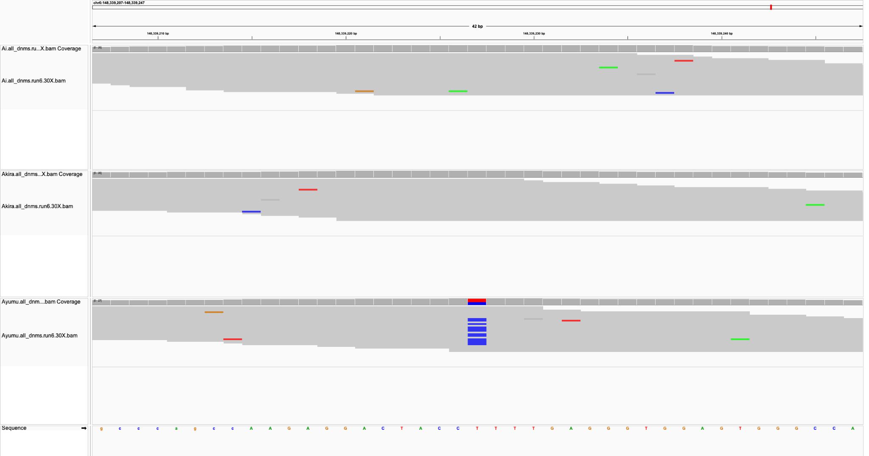
Sire
Dam
Child

Slide 17
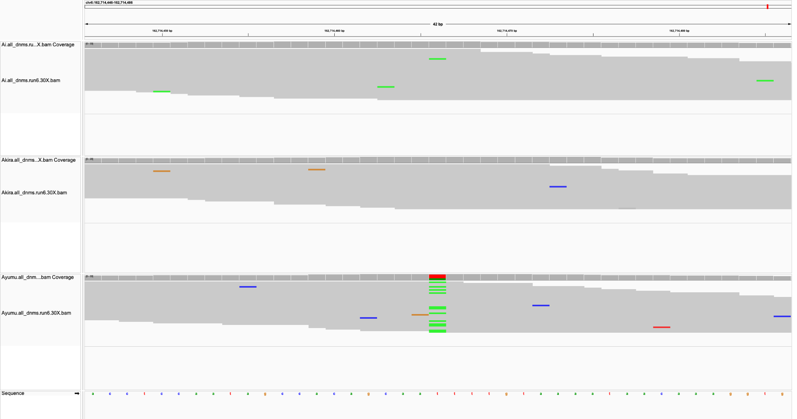
Sire
Dam
Child

Slide 18
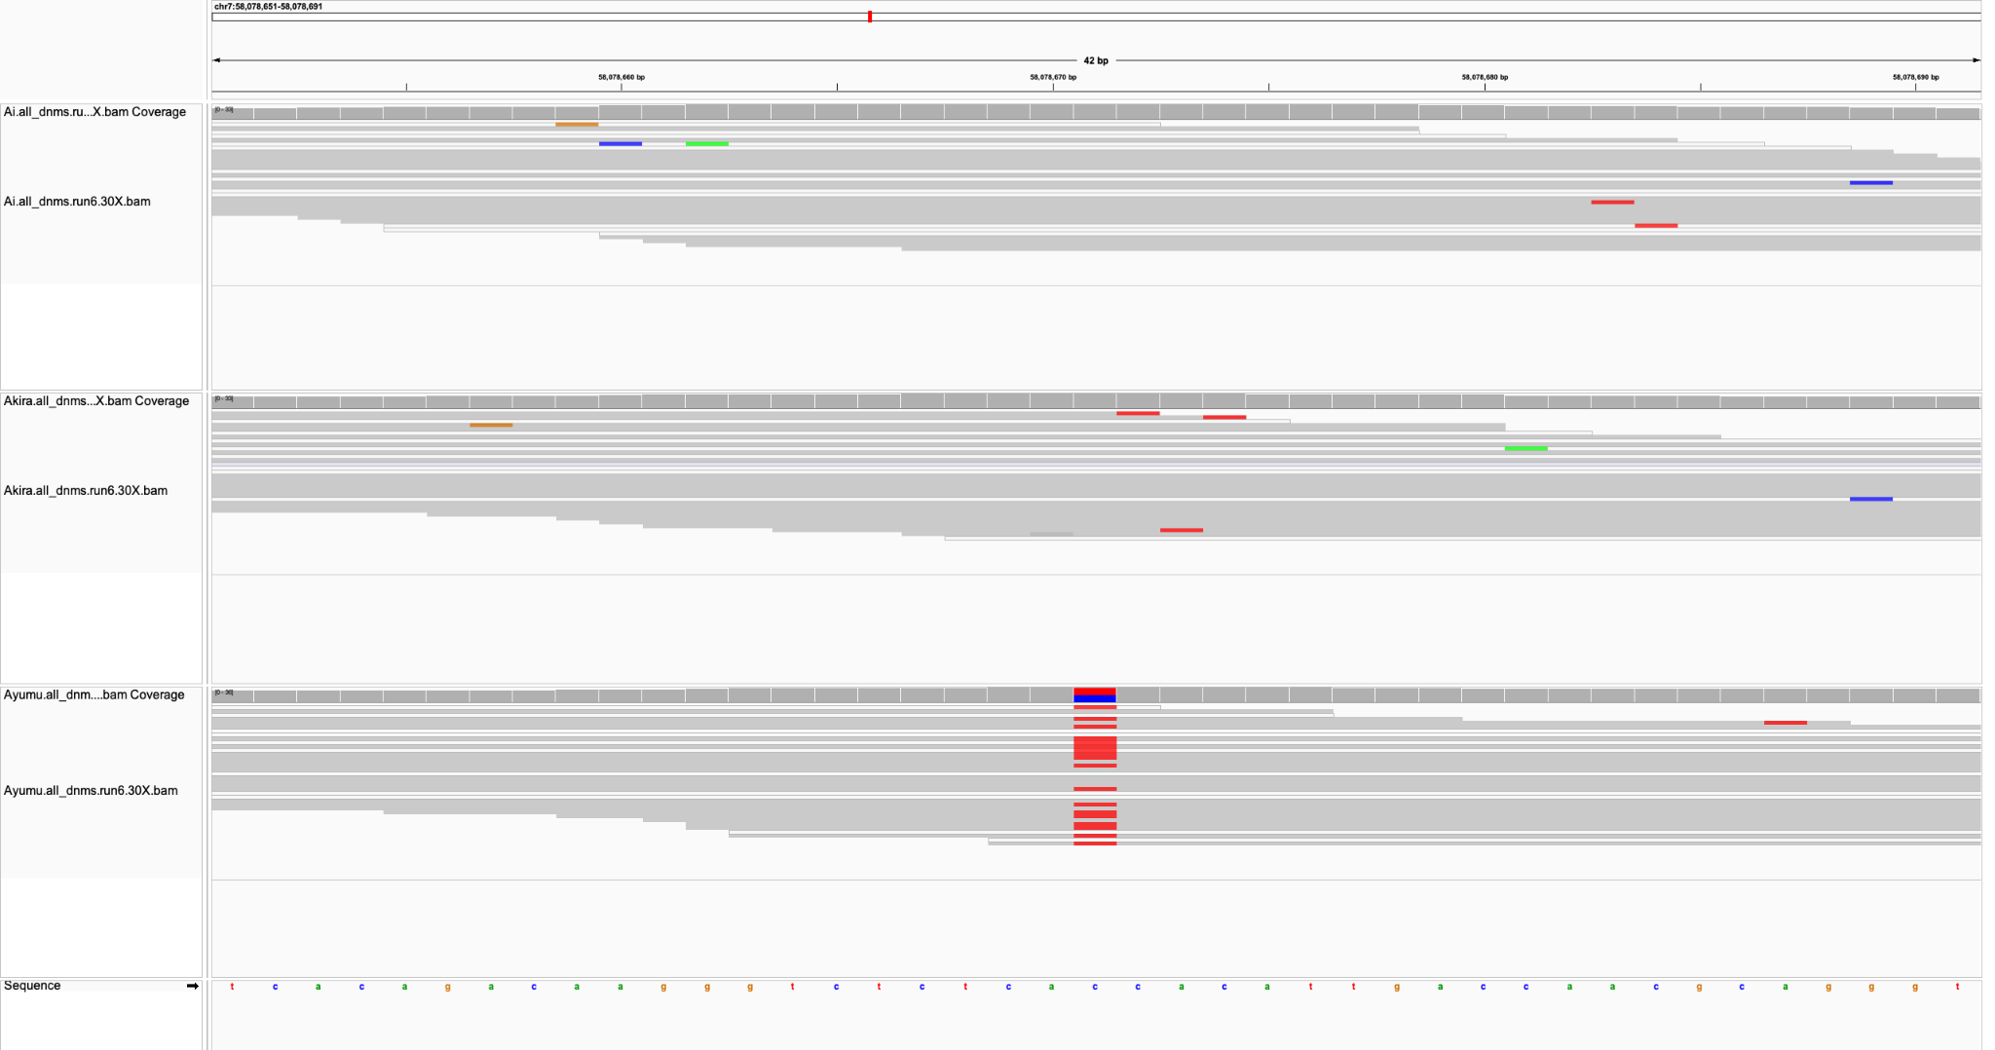
Sire
Dam
Child

Slide 19
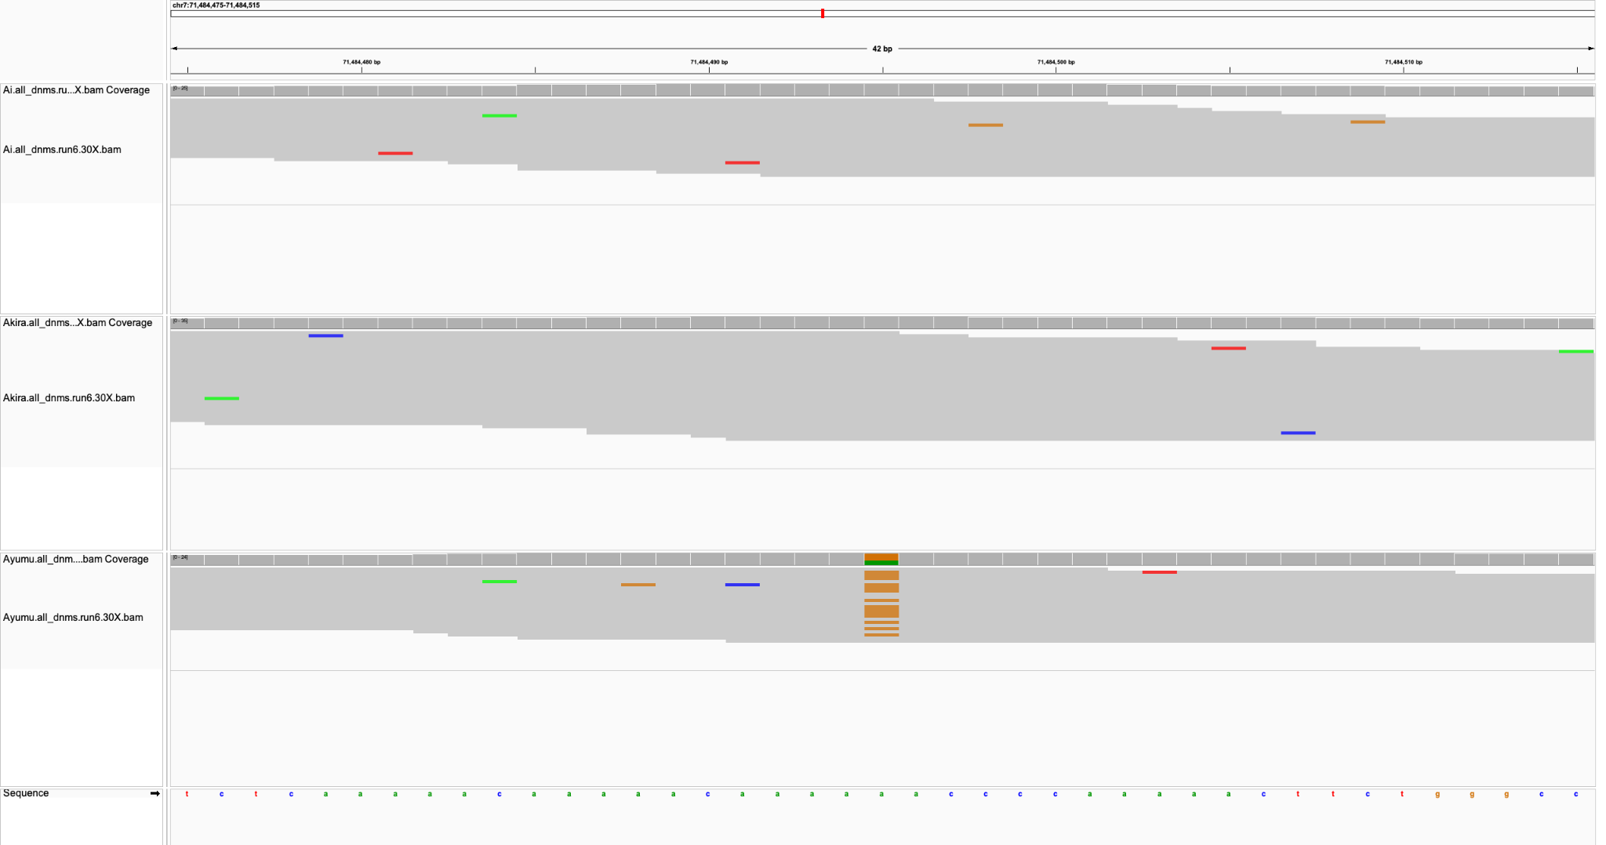
Sire
Dam
Child

Slide 20
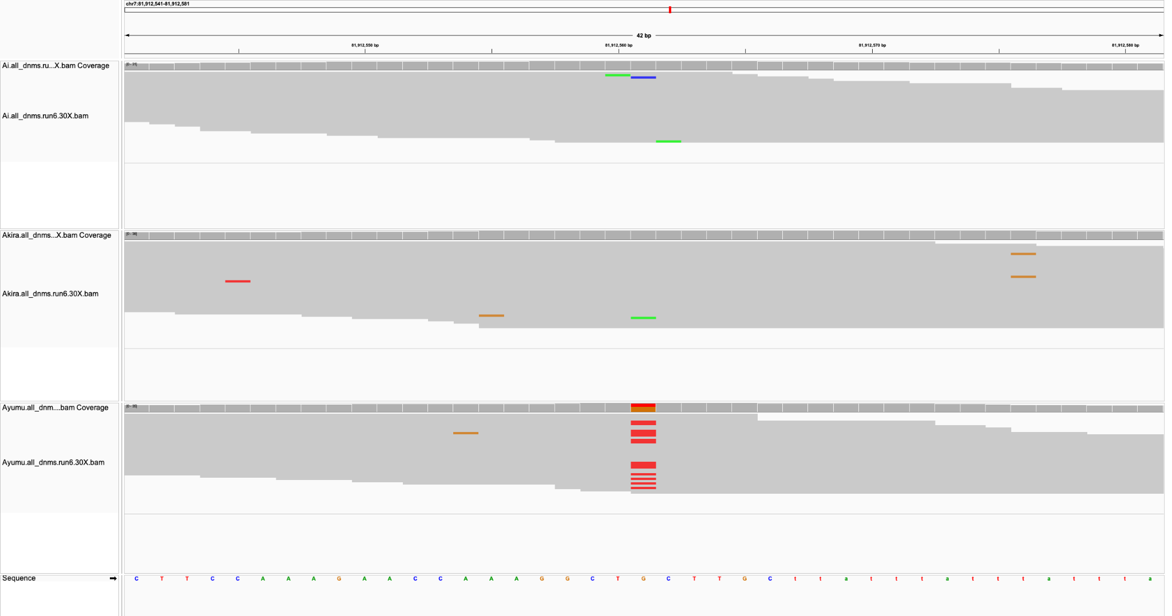
Sire
Dam
Child

Slide 21
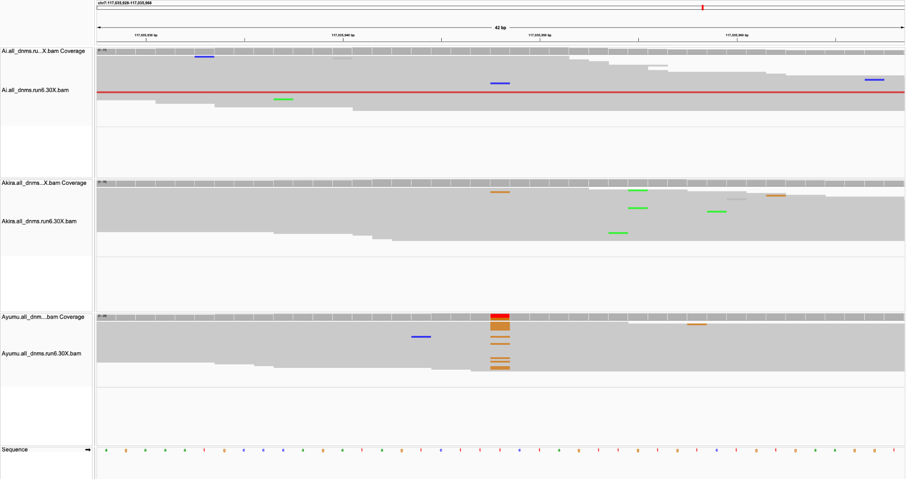
Sire
Dam
Child

Slide 22
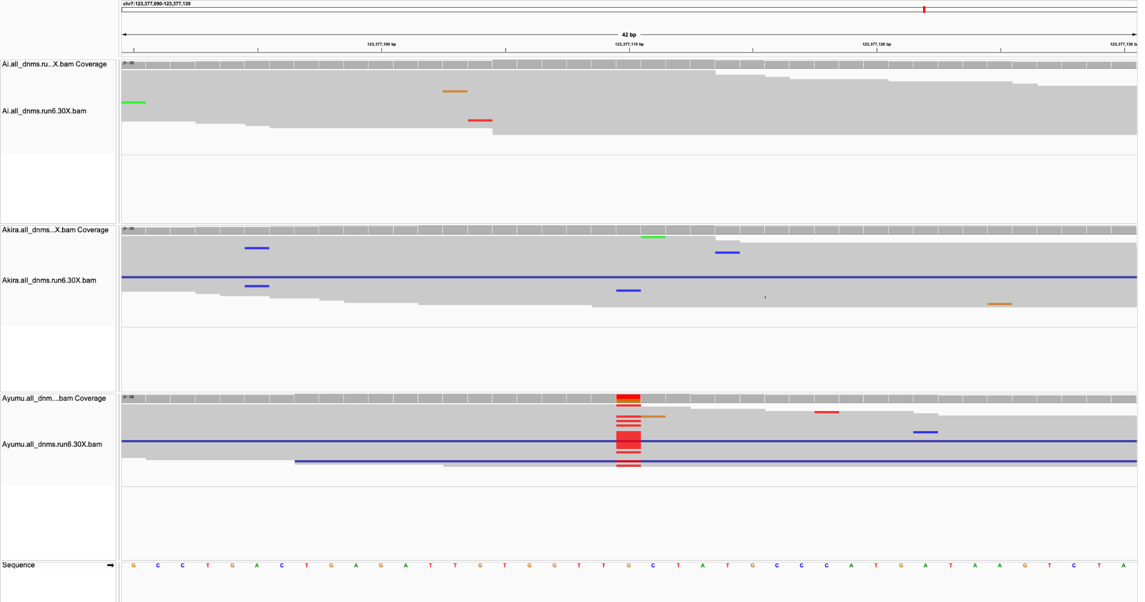
Sire
Dam
Child

Slide 23
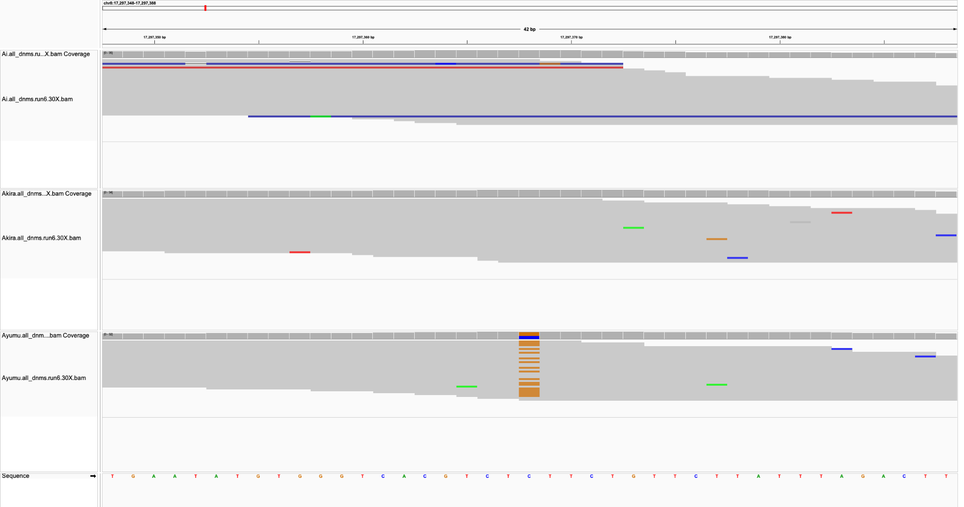
Sire
Dam
Child

Slide 24
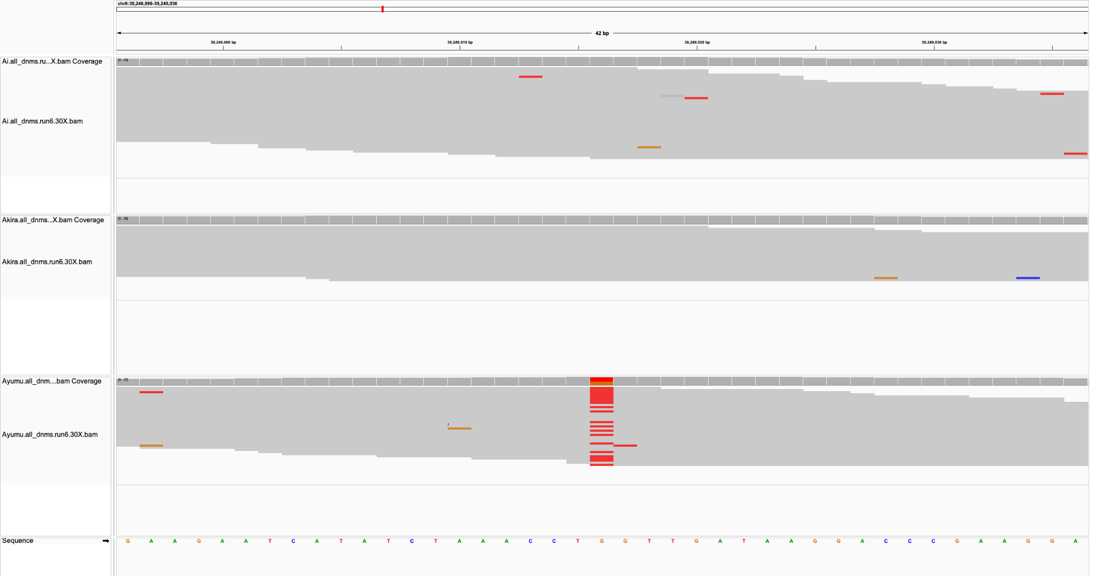
Sire
Dam
Child

Slide 25
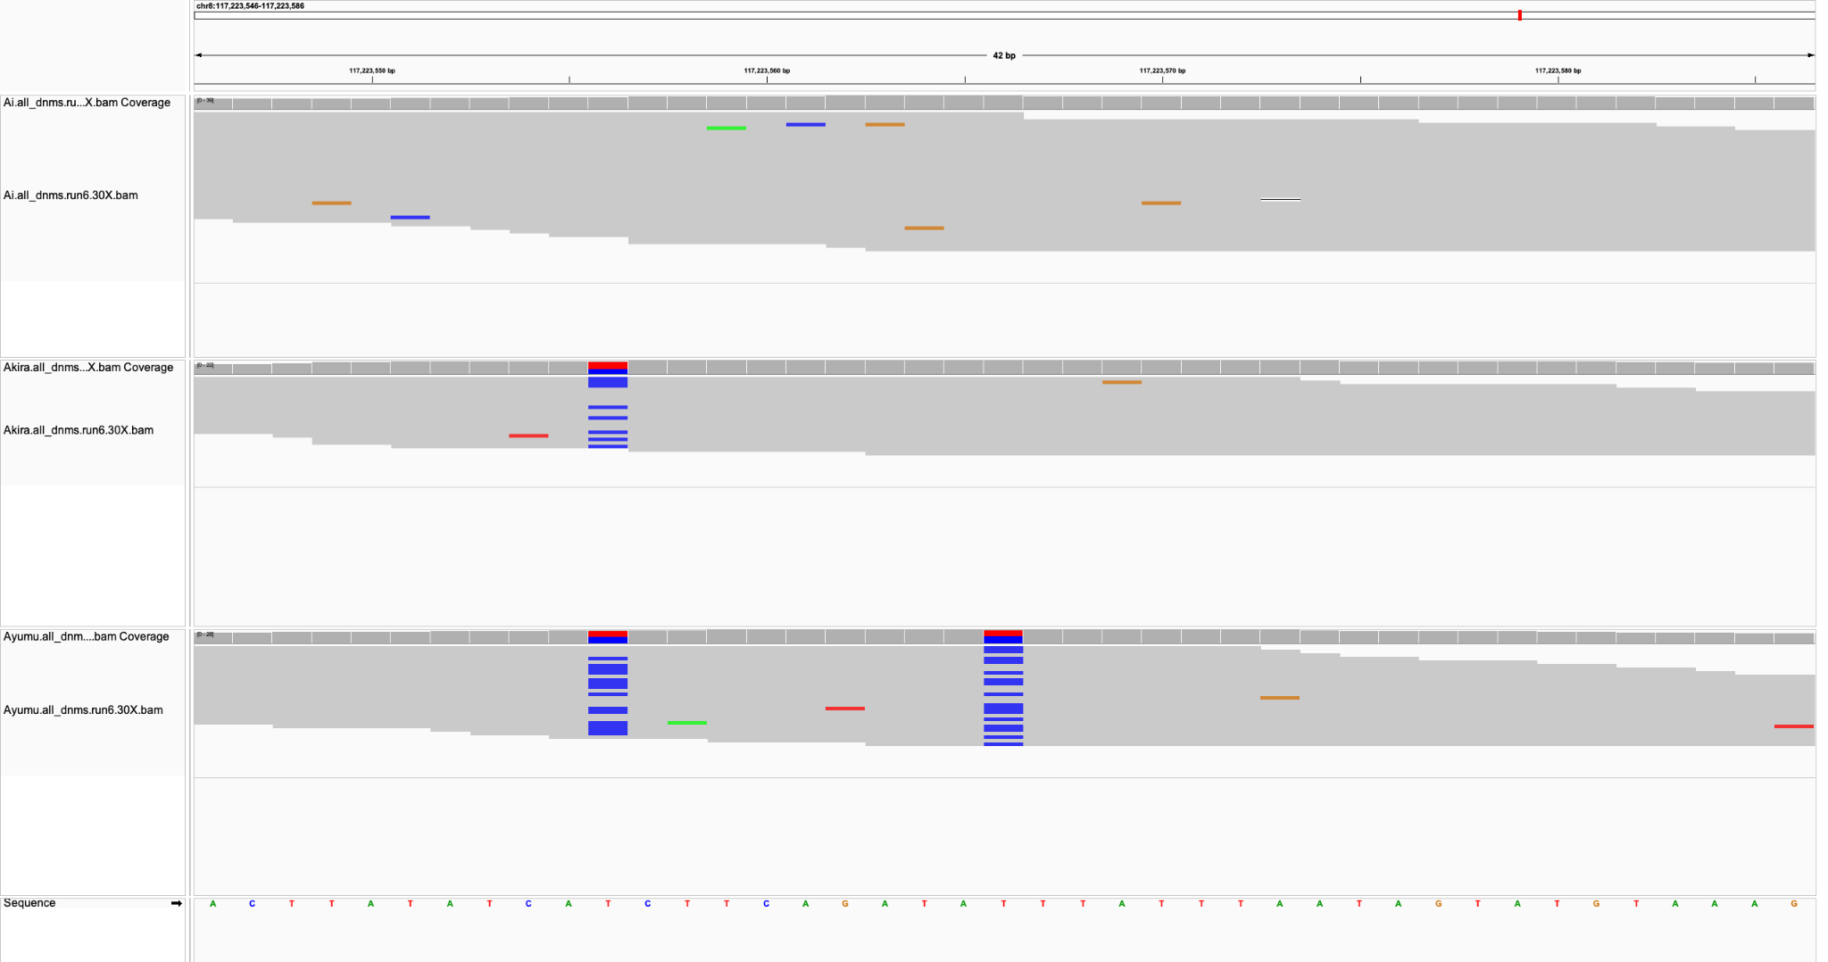
Sire
Dam
Child

Slide 26
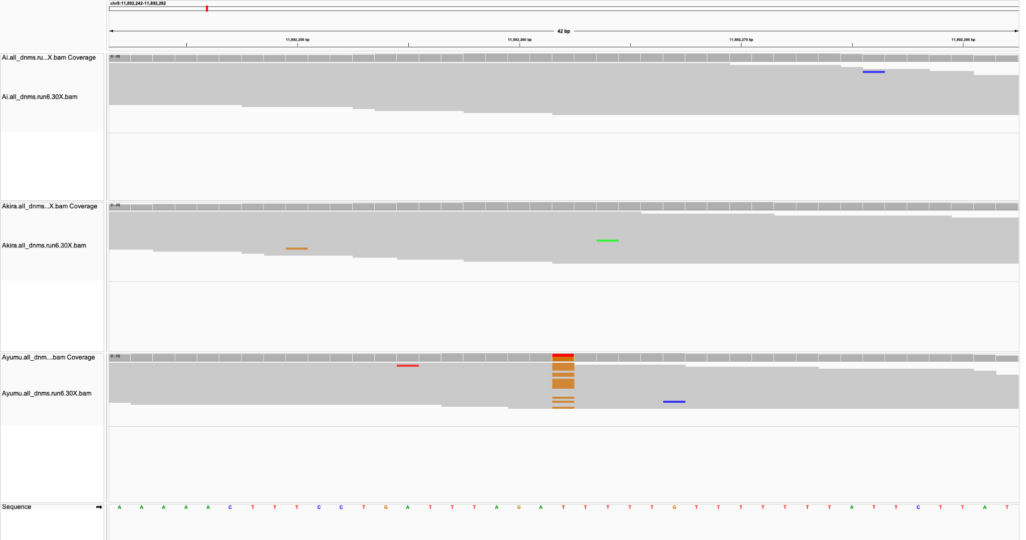
Sire
Dam
Child

Slide 27
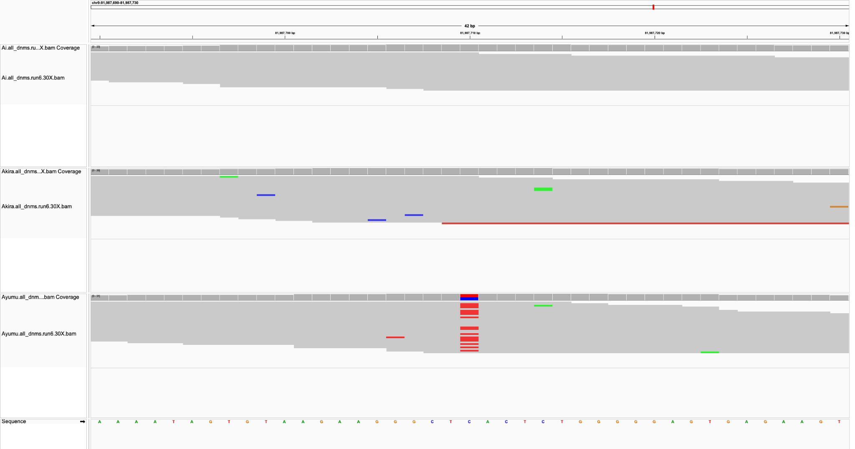
Sire
Dam
Child

Slide 28
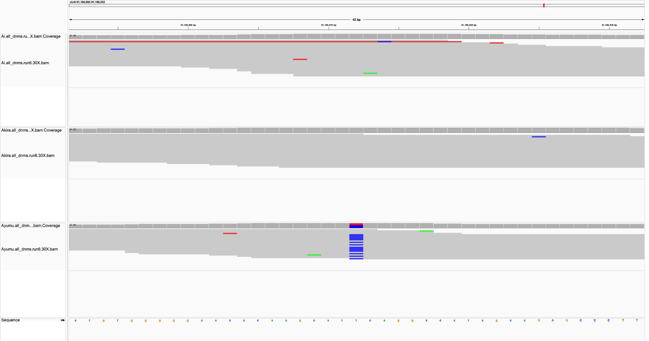
Sire
Dam
Child

Slide 29
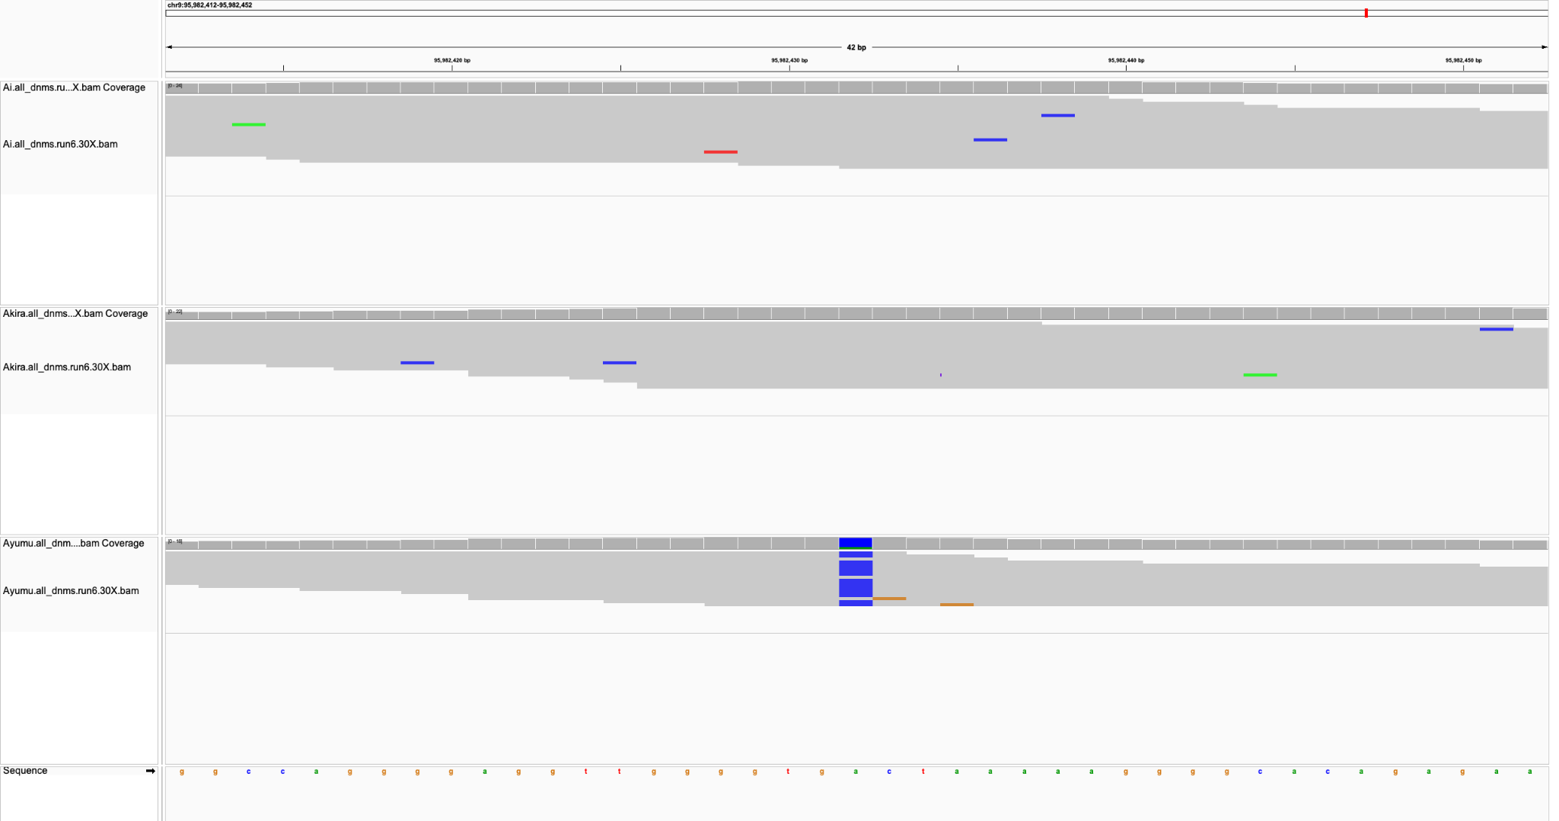
Sire
Dam
Child

Slide 30
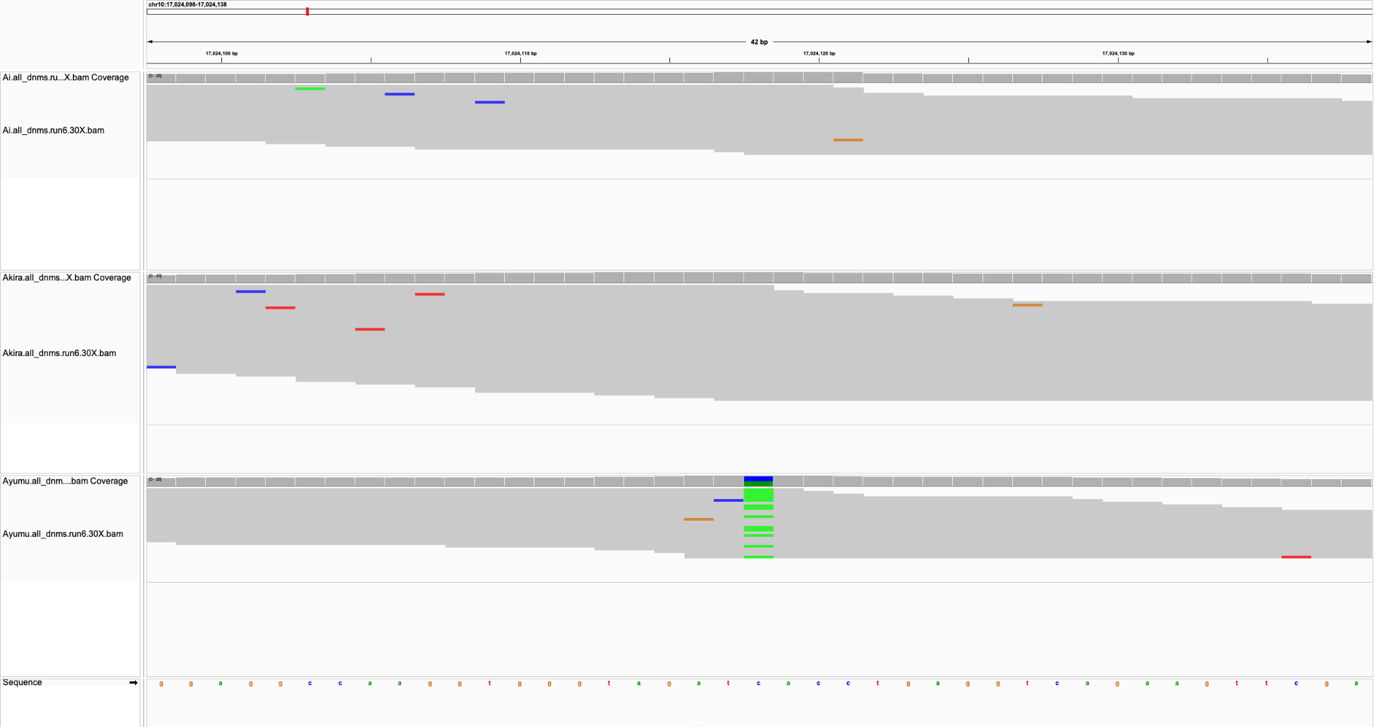
Sire
Dam
Child

Slide 31
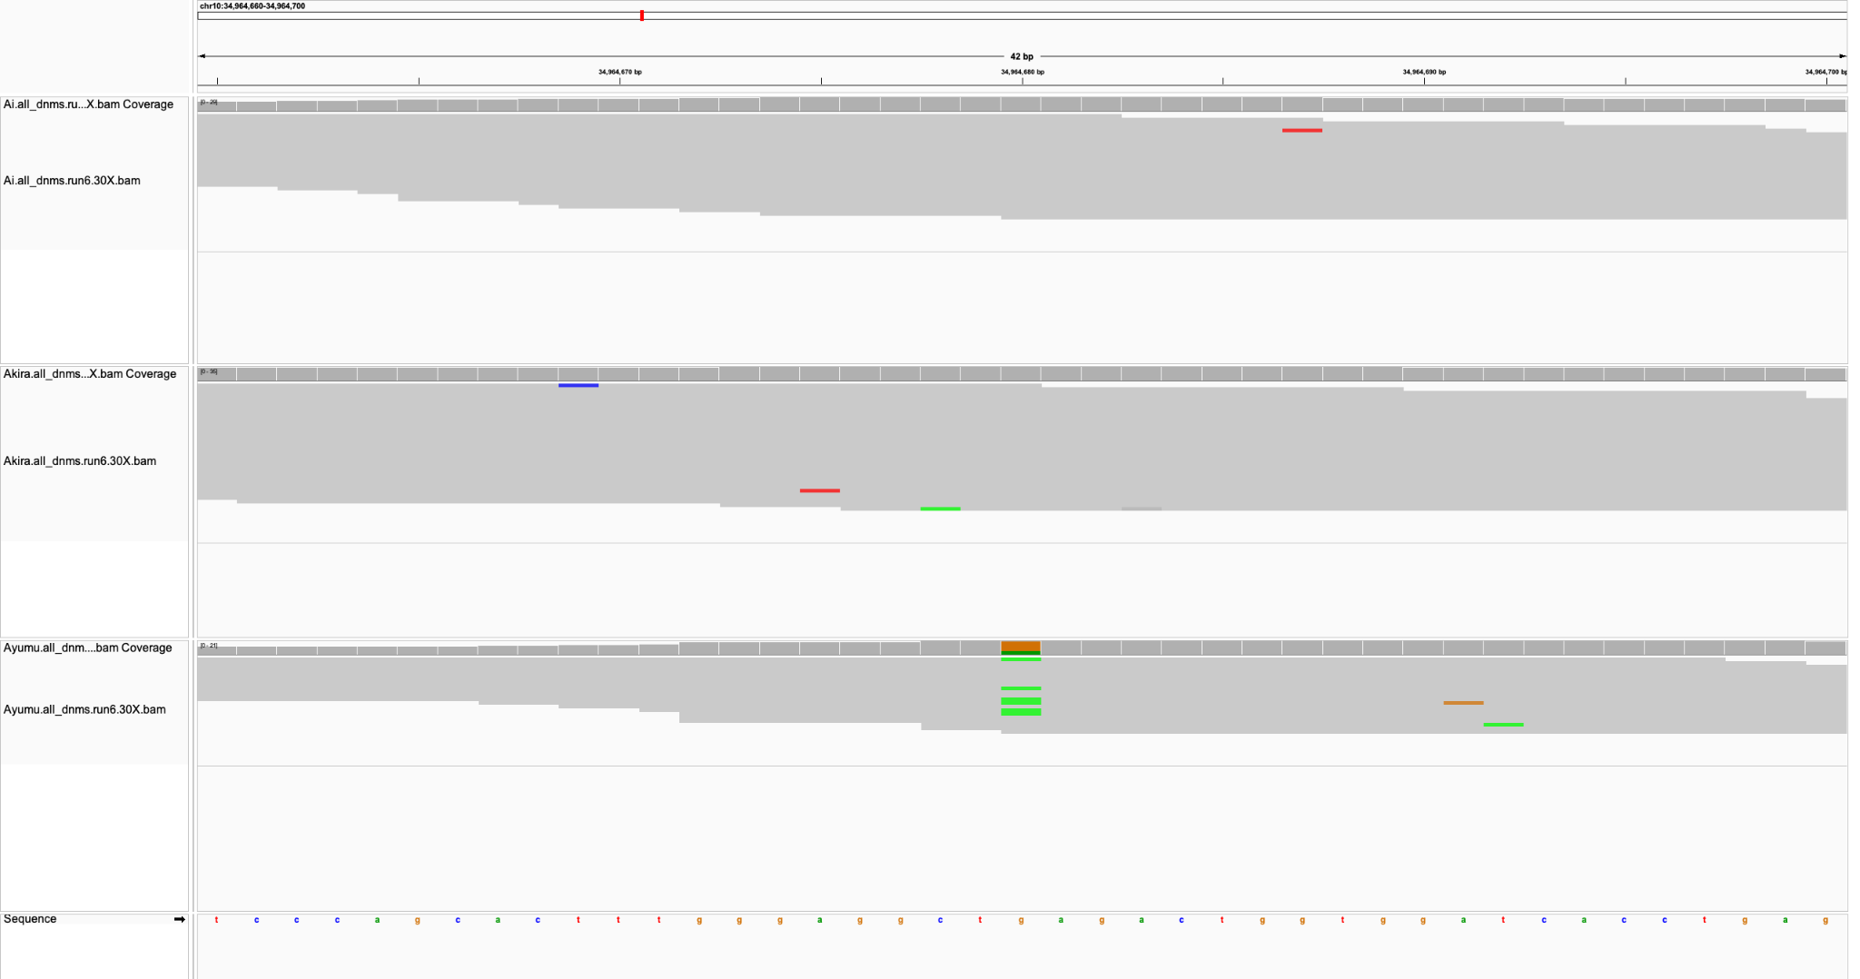
Sire
Dam
Child

Slide 32
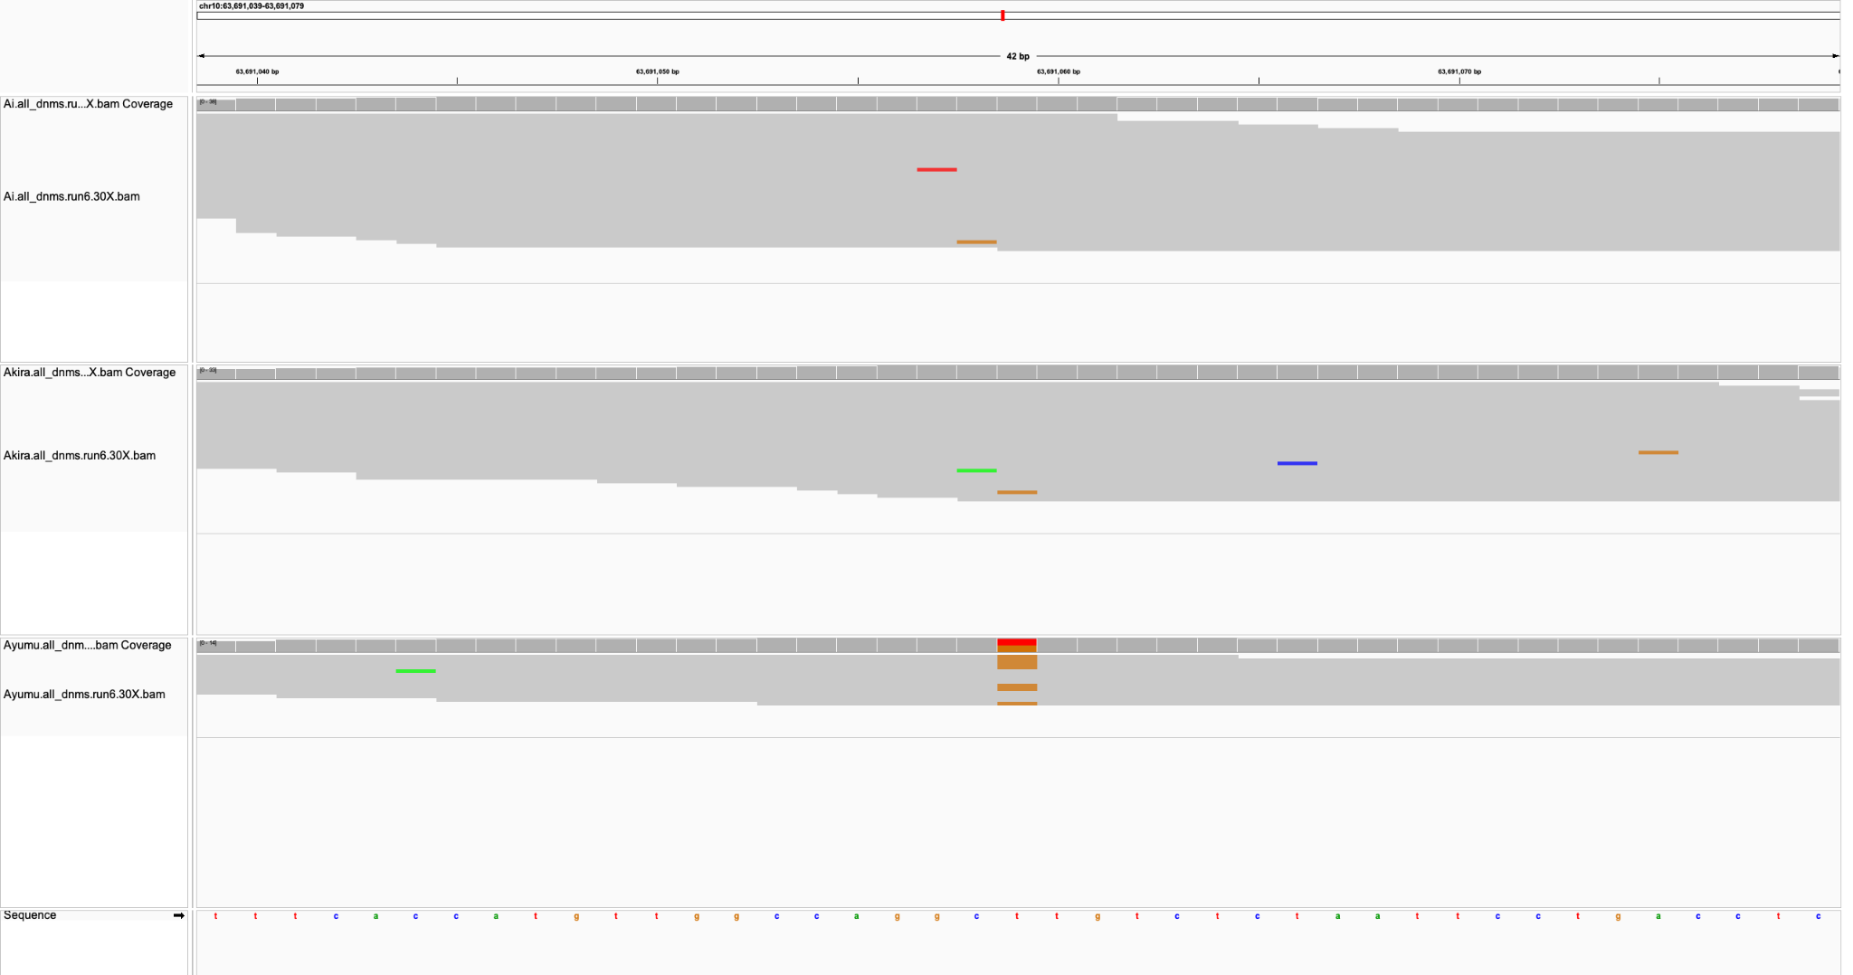
Sire
Dam
Child

Slide 33
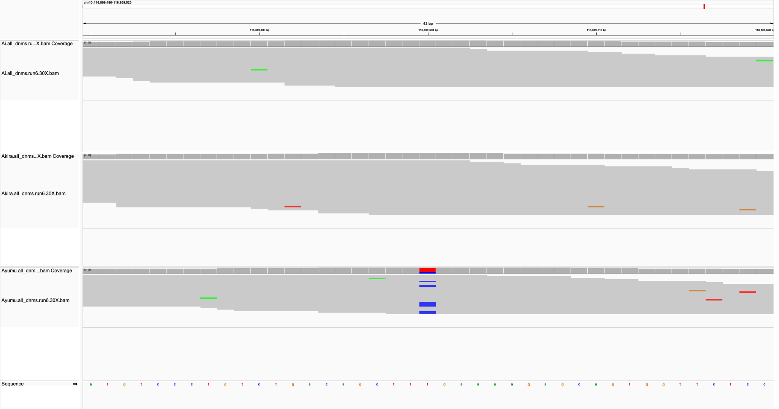
Sire
Dam
Child

Slide 34
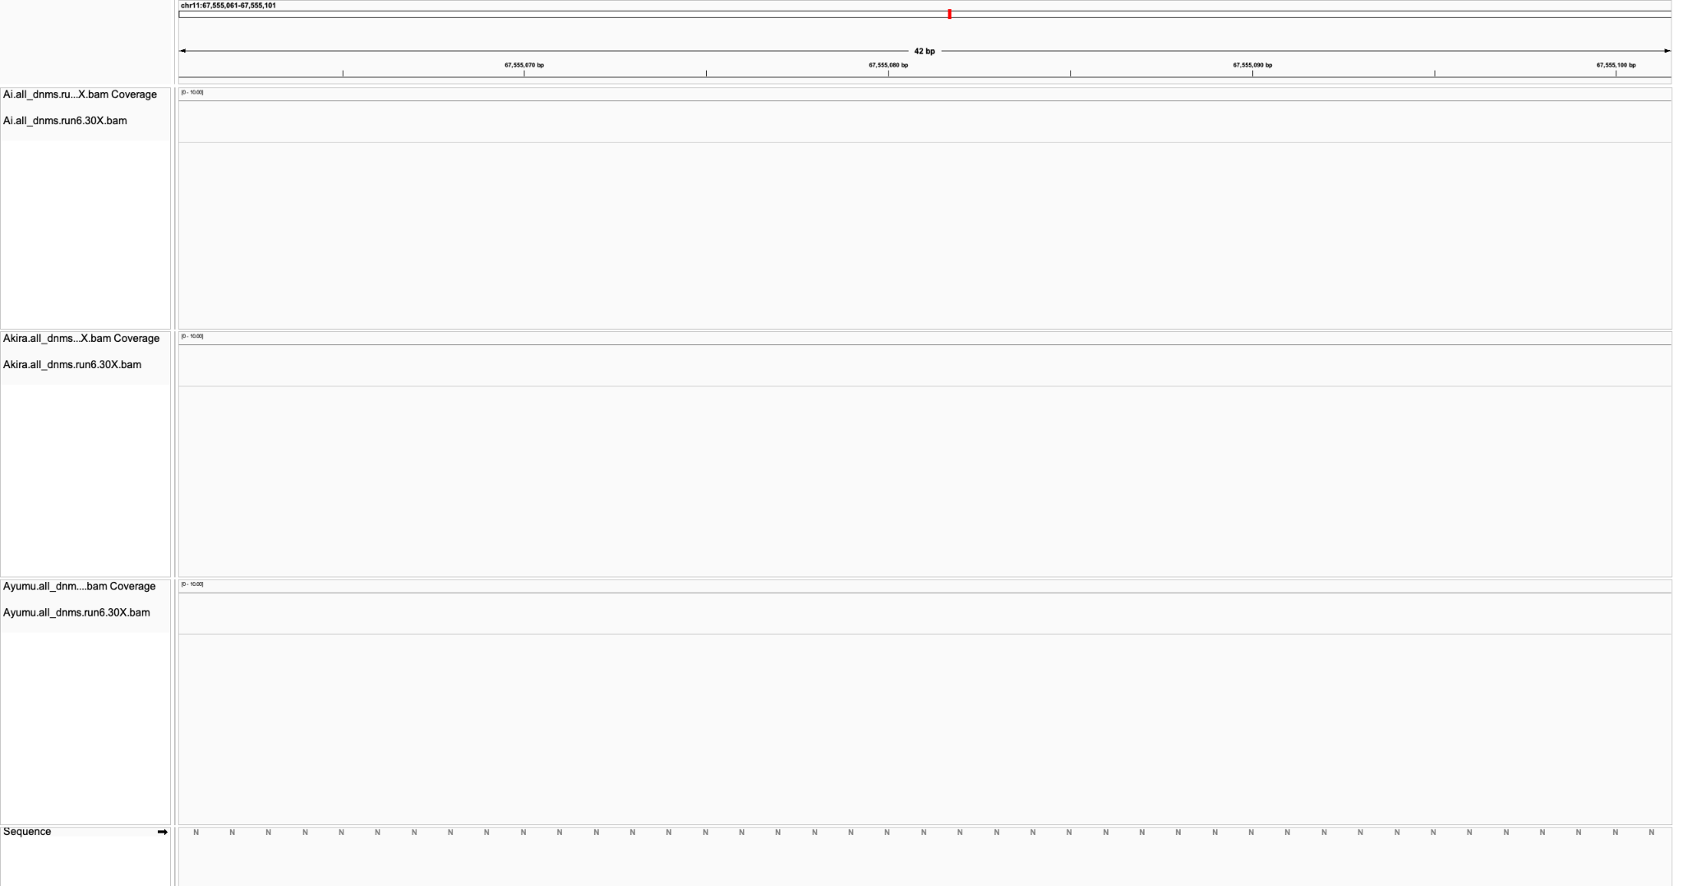

Slide 35
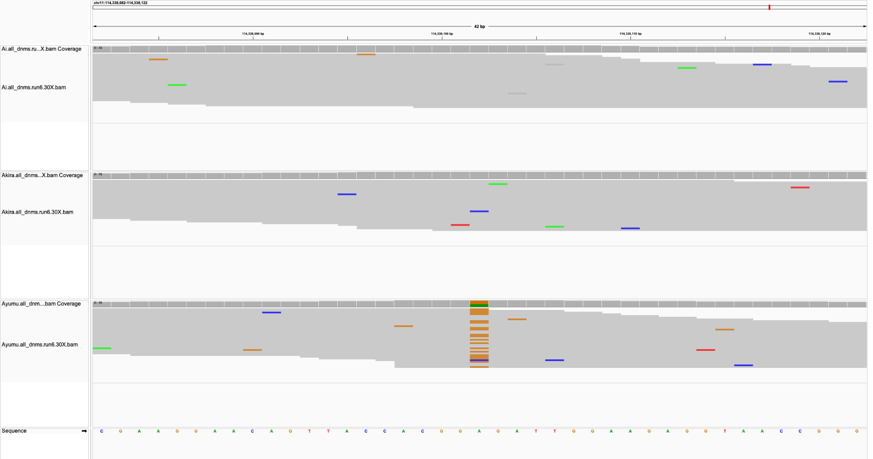
Sire
Dam
Child

Slide 36
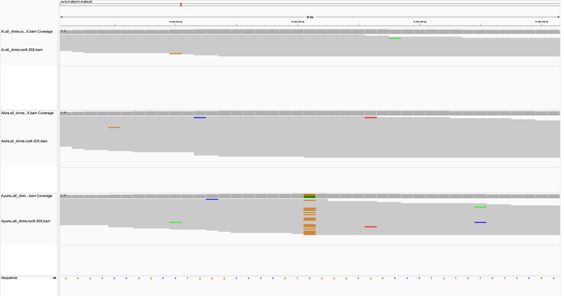
Sire
Dam
Child

Slide 37
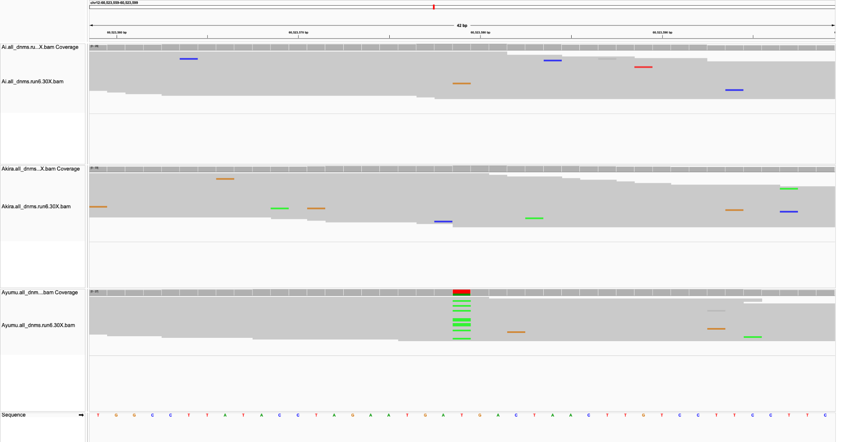
Sire
Dam
Child

Slide 38
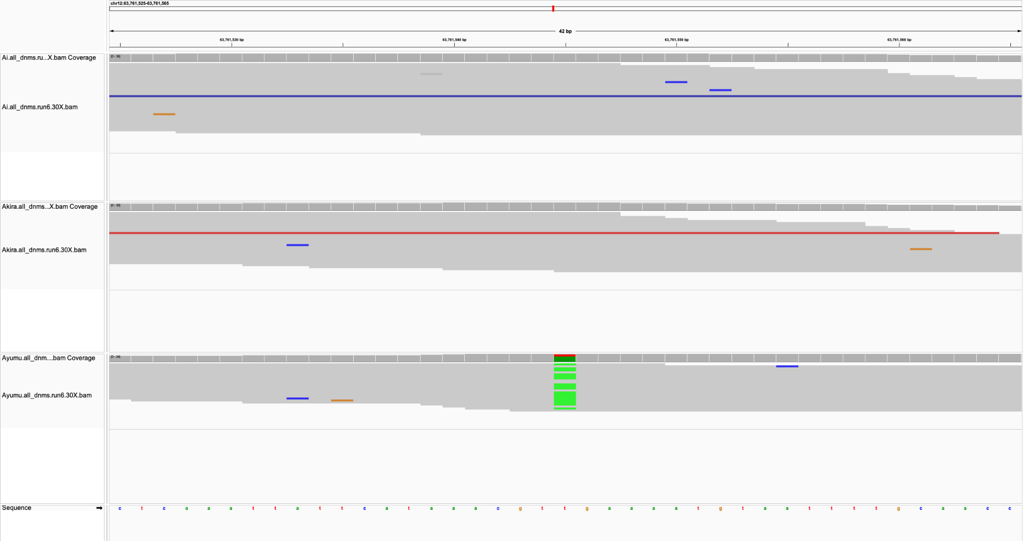
Sire
Dam
Child

Slide 39
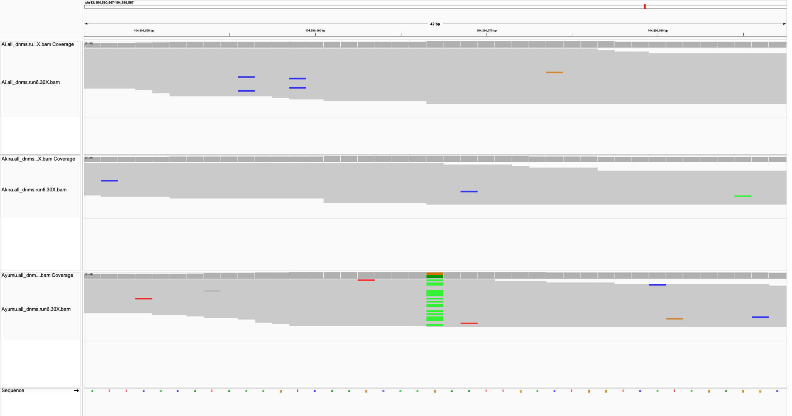
Sire
Dam
Child

Slide 40
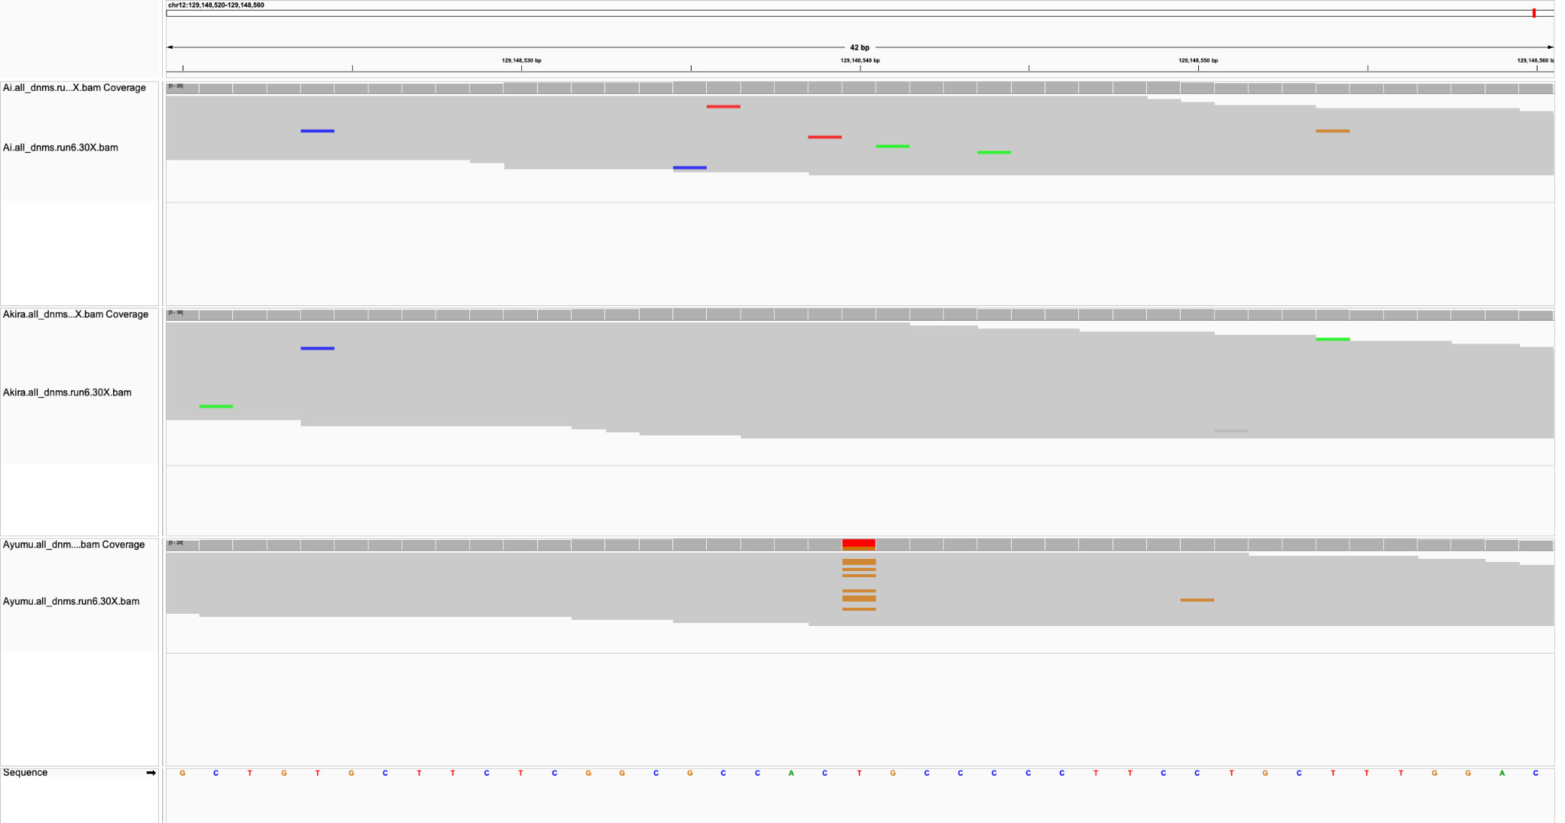
Sire
Dam
Child

Slide 41
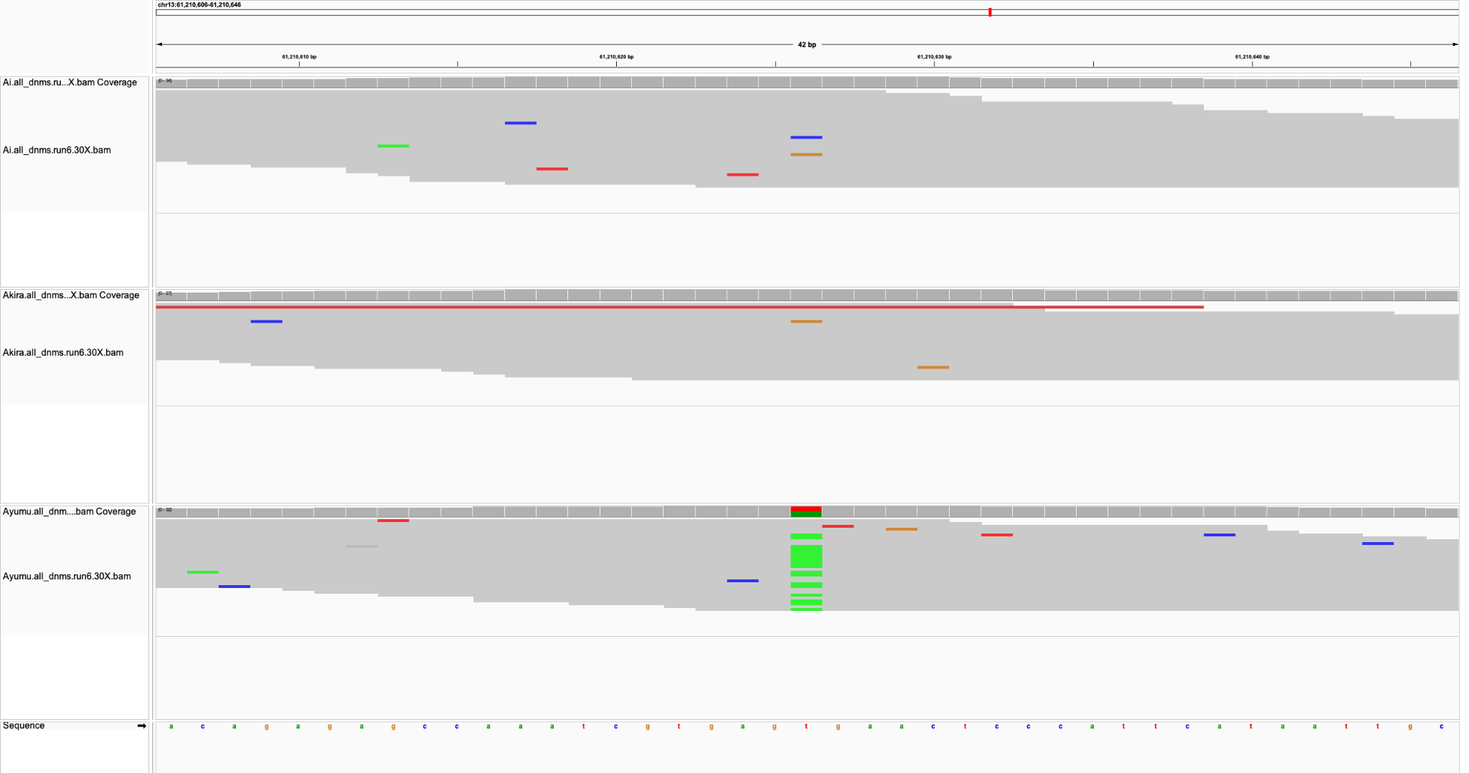
Sire
Dam
Child

Slide 42
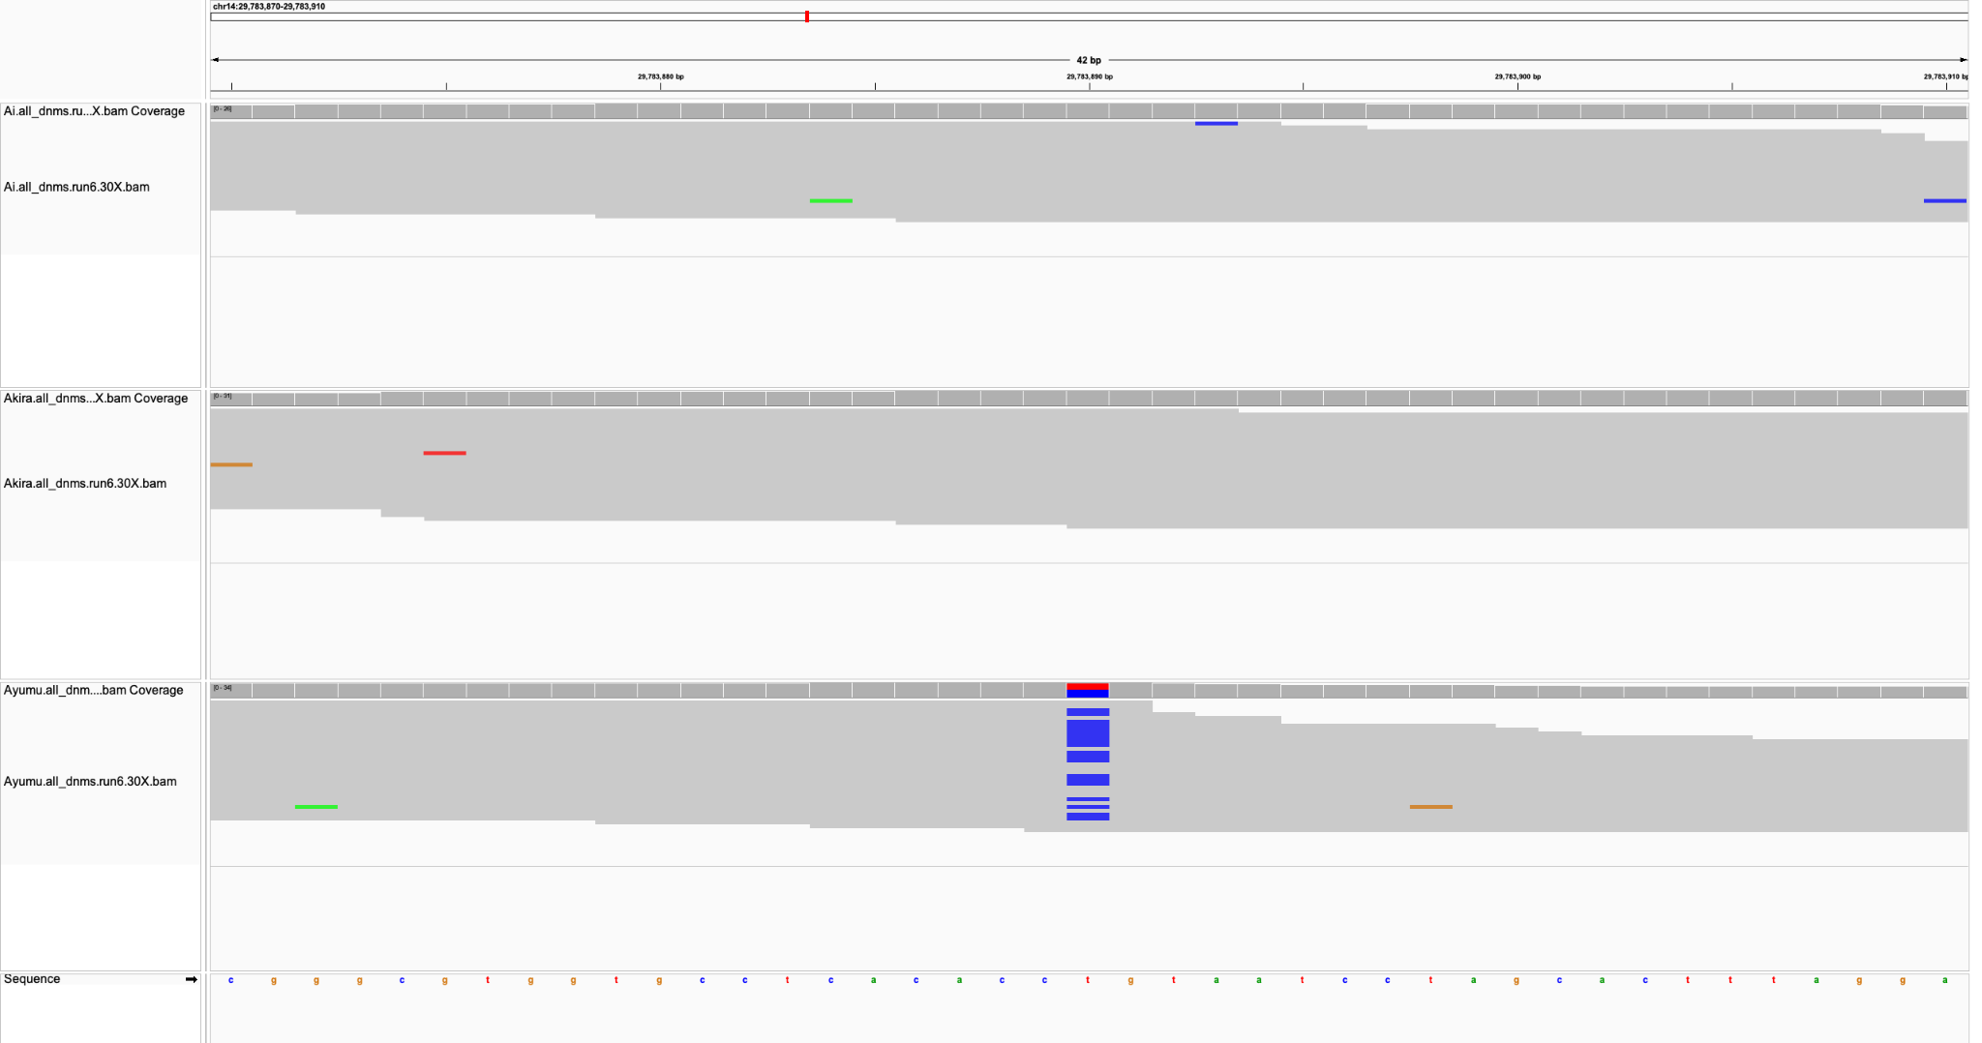
Sire
Dam
Child

Slide 43
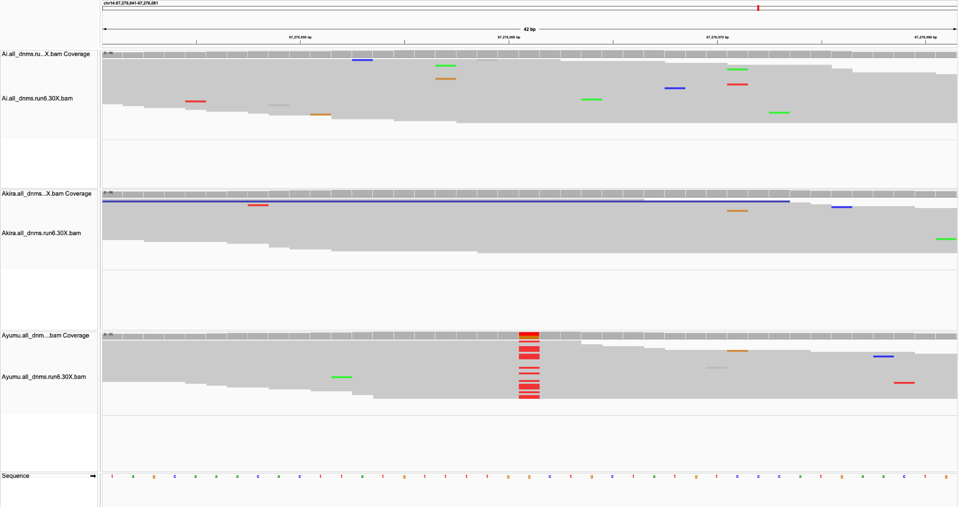
Sire
Dam
Child

Slide 44
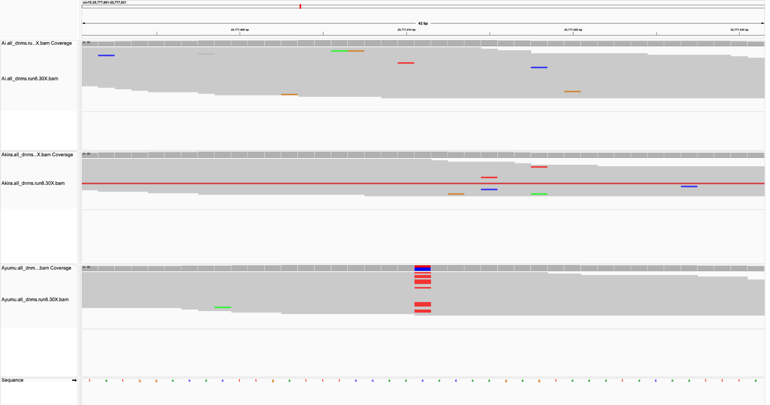
Sire
Dam
Child

Slide 45
Sire
Dam
Child

Slide 46
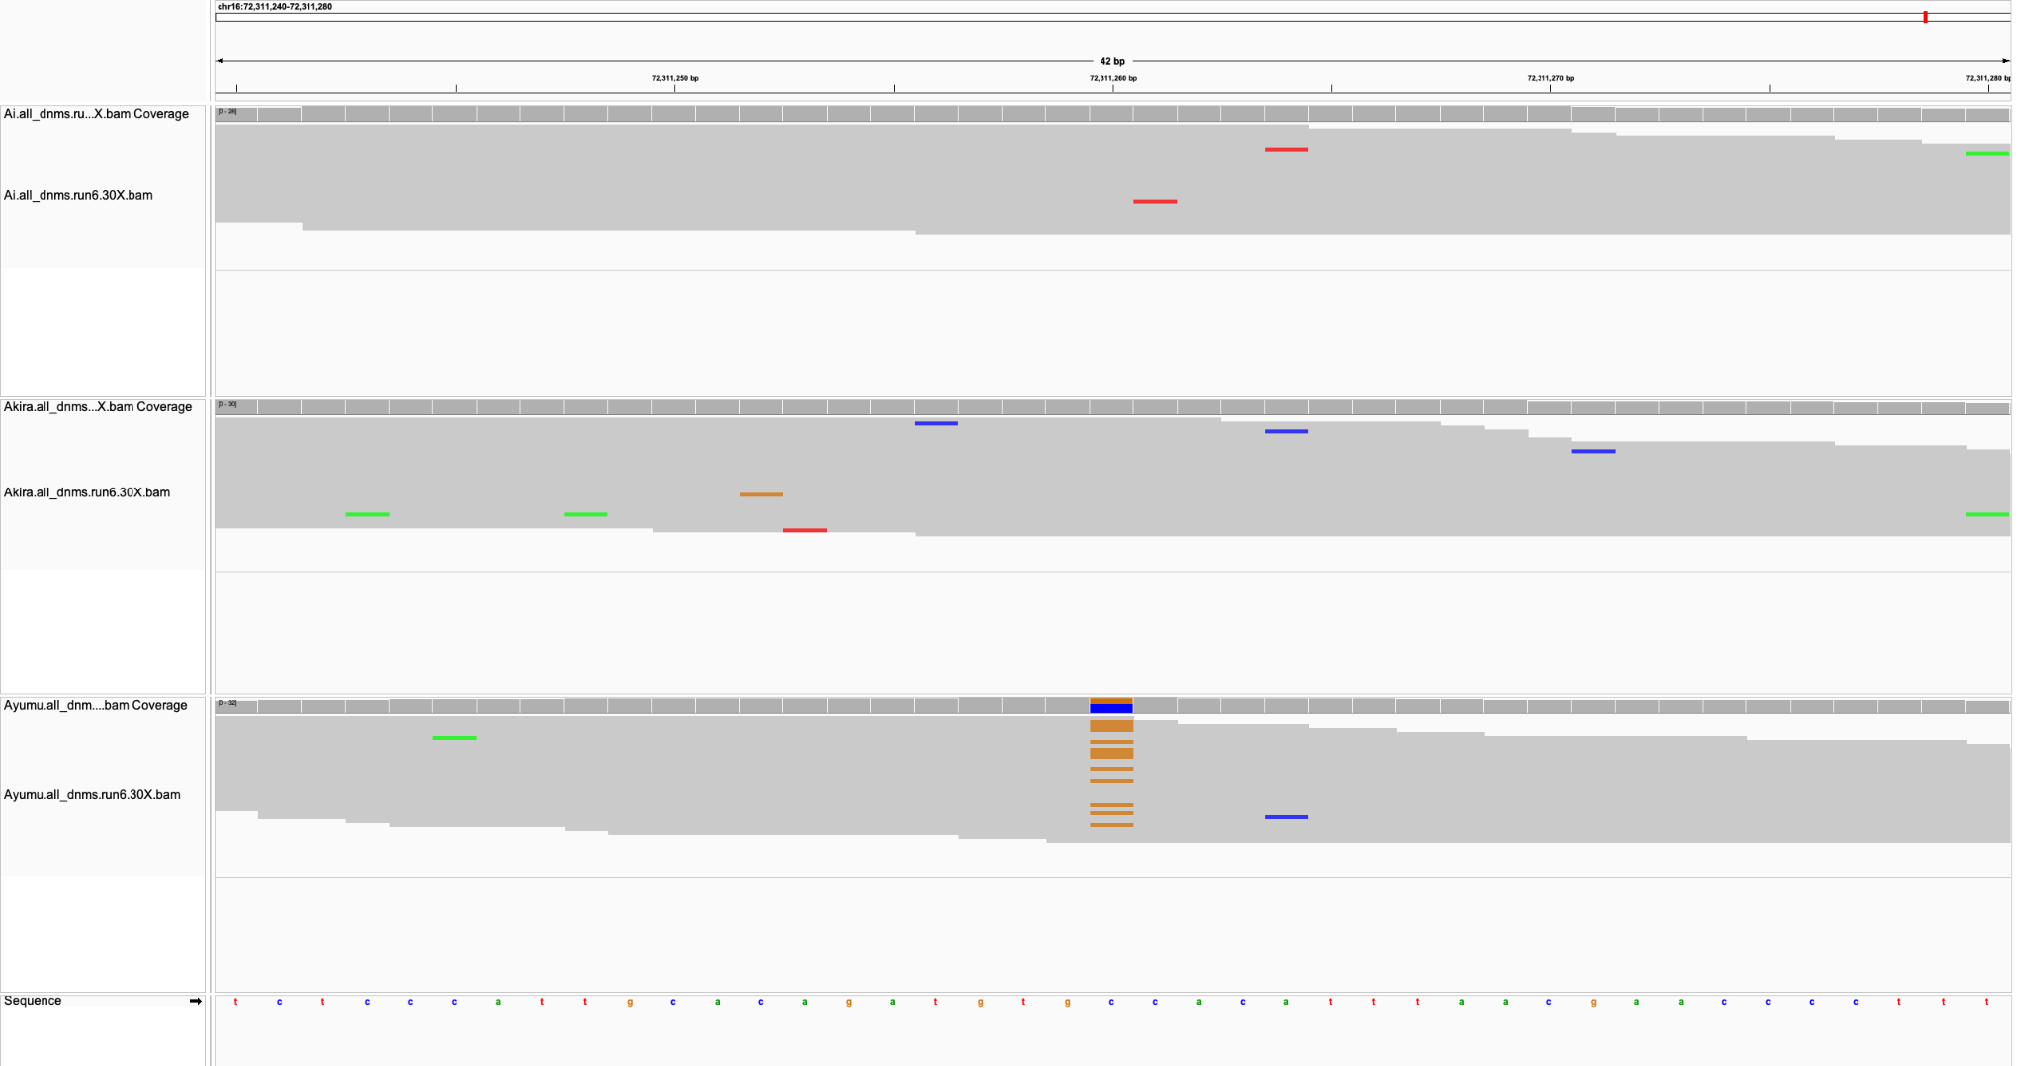
Sire
Dam
Child

Slide 47
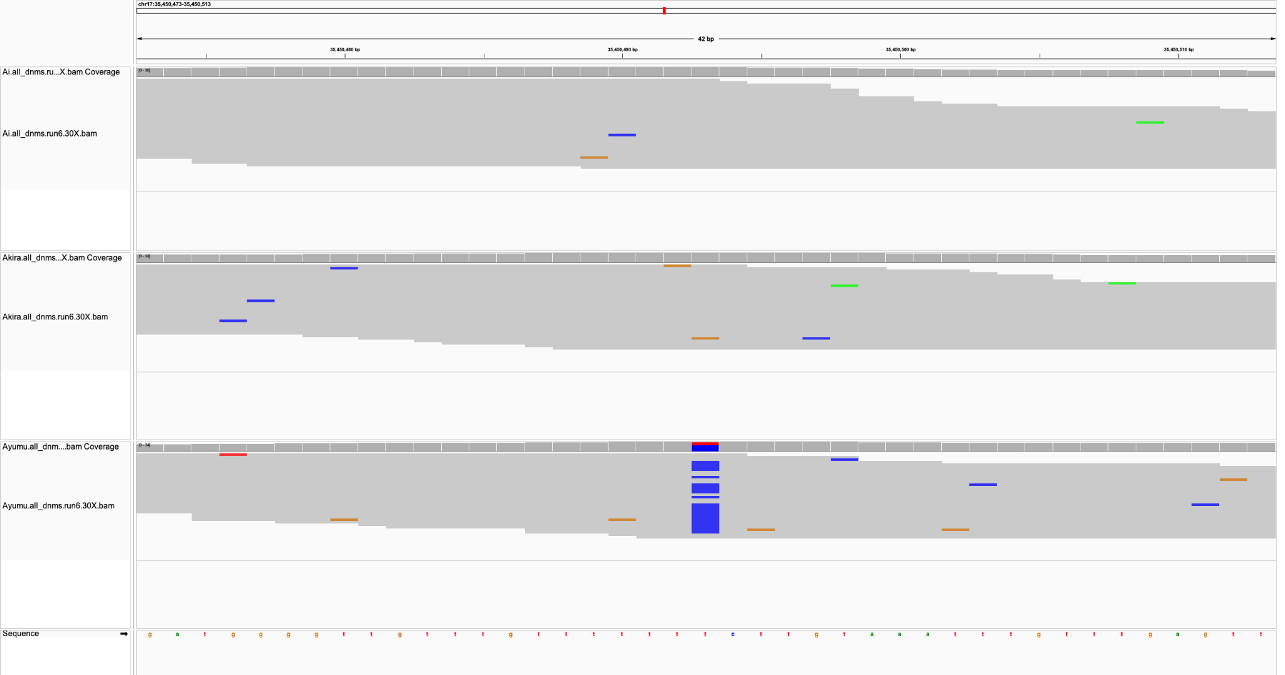
Sire
Dam
Child

Slide 48
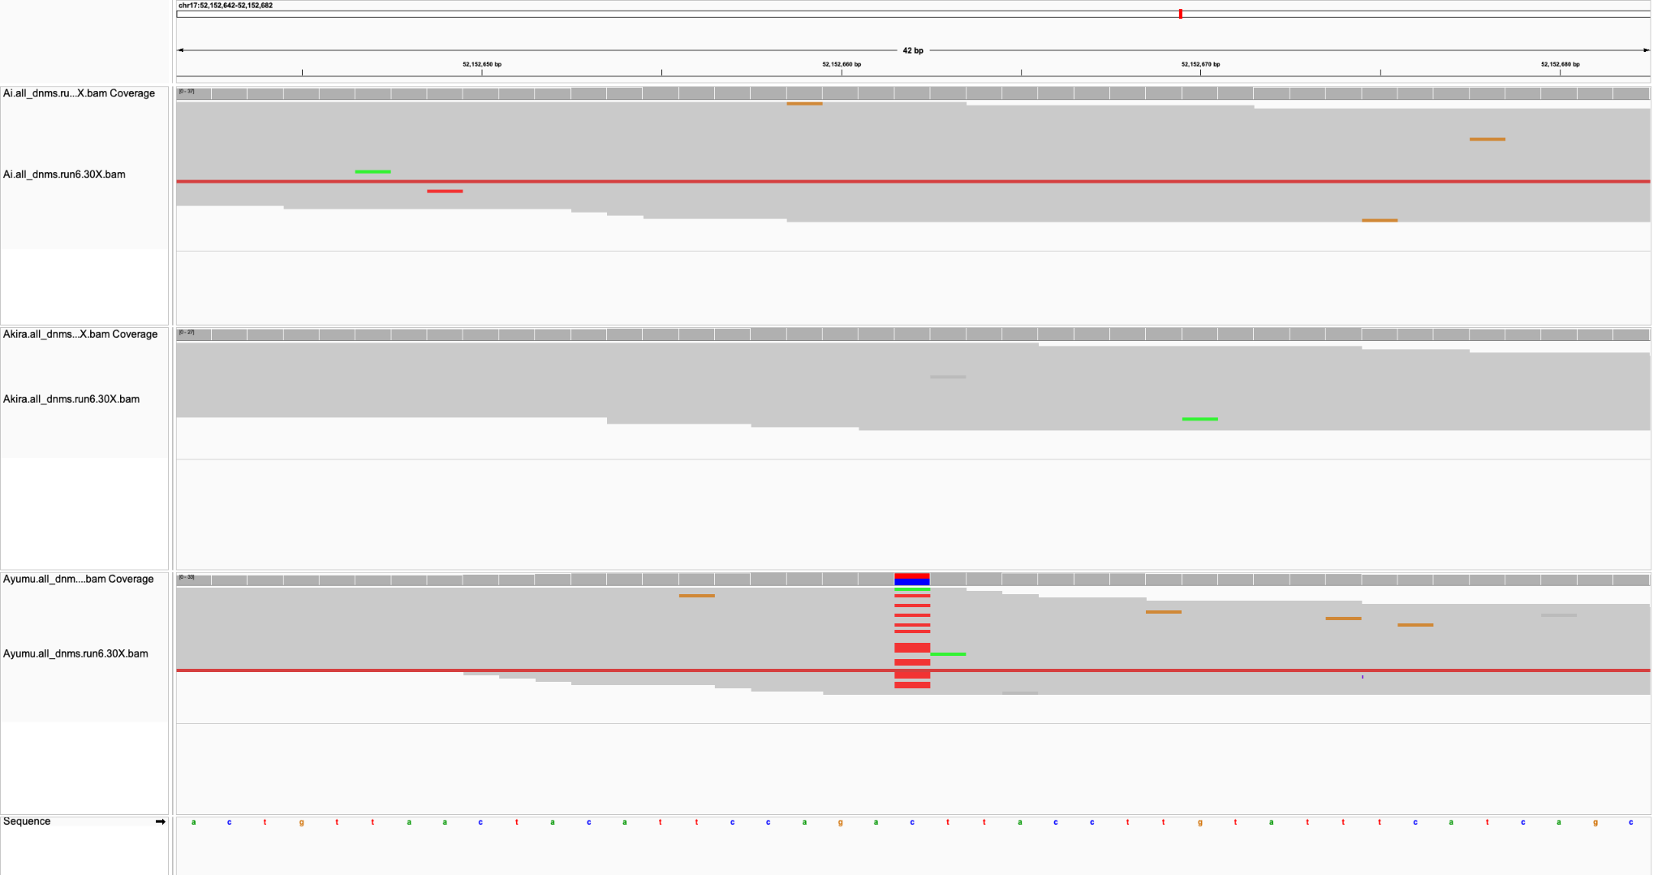
Sire
Dam
Child

Slide 49
Sire
Dam
Child

Slide 50
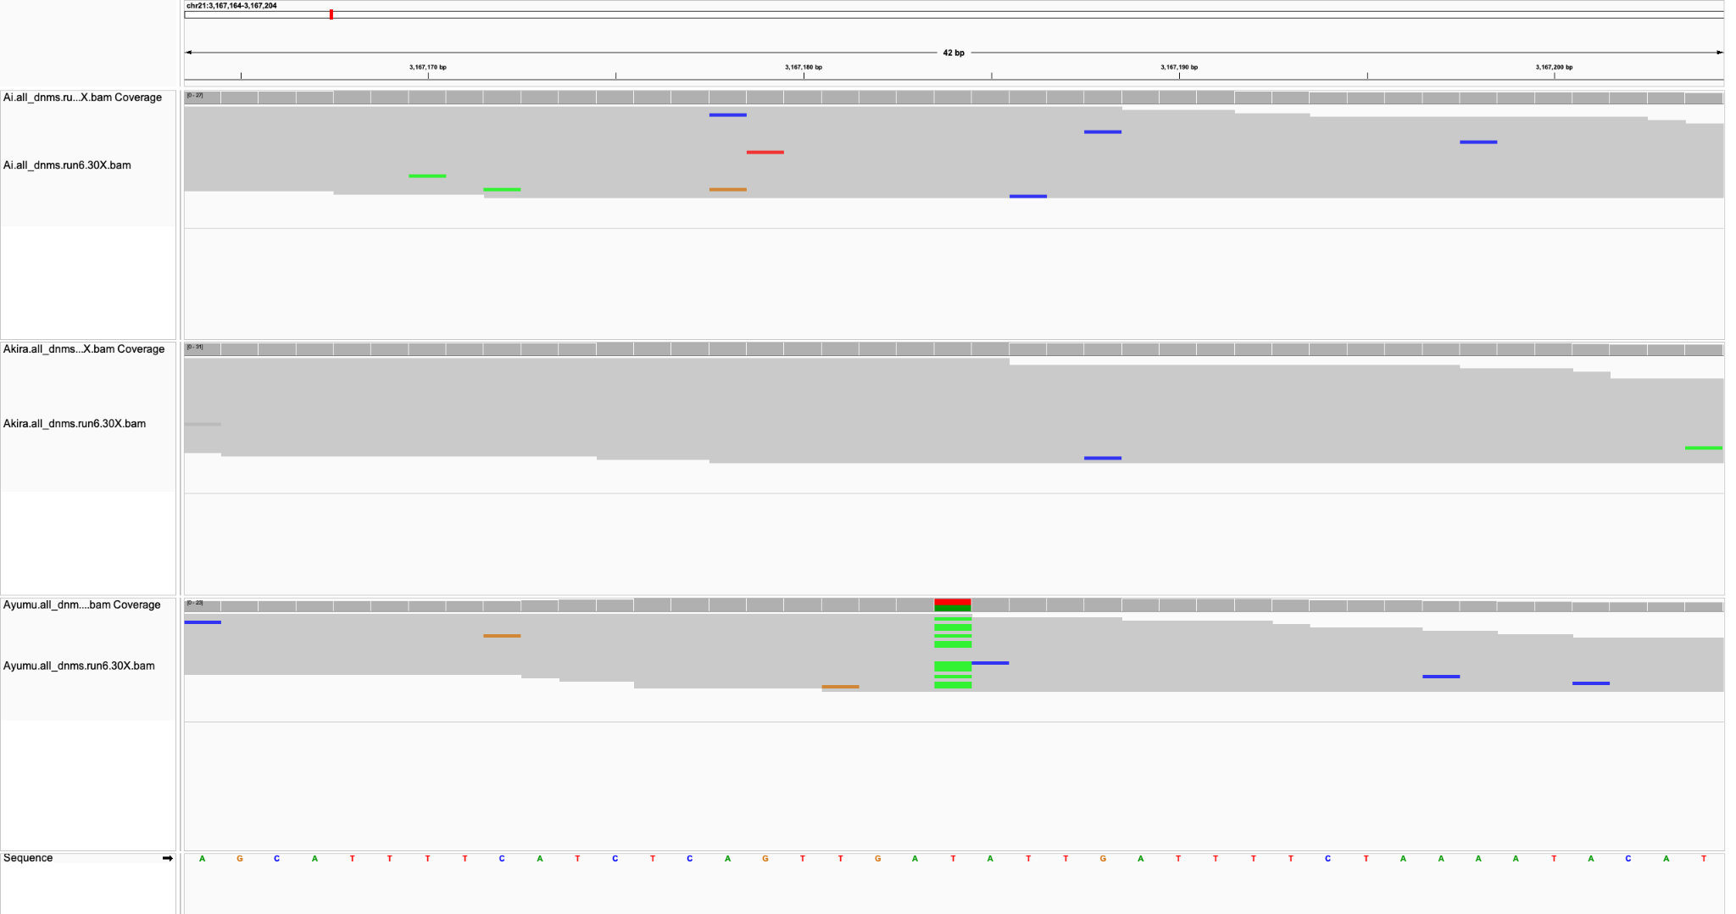
Sire
Dam
Child

Slide 51
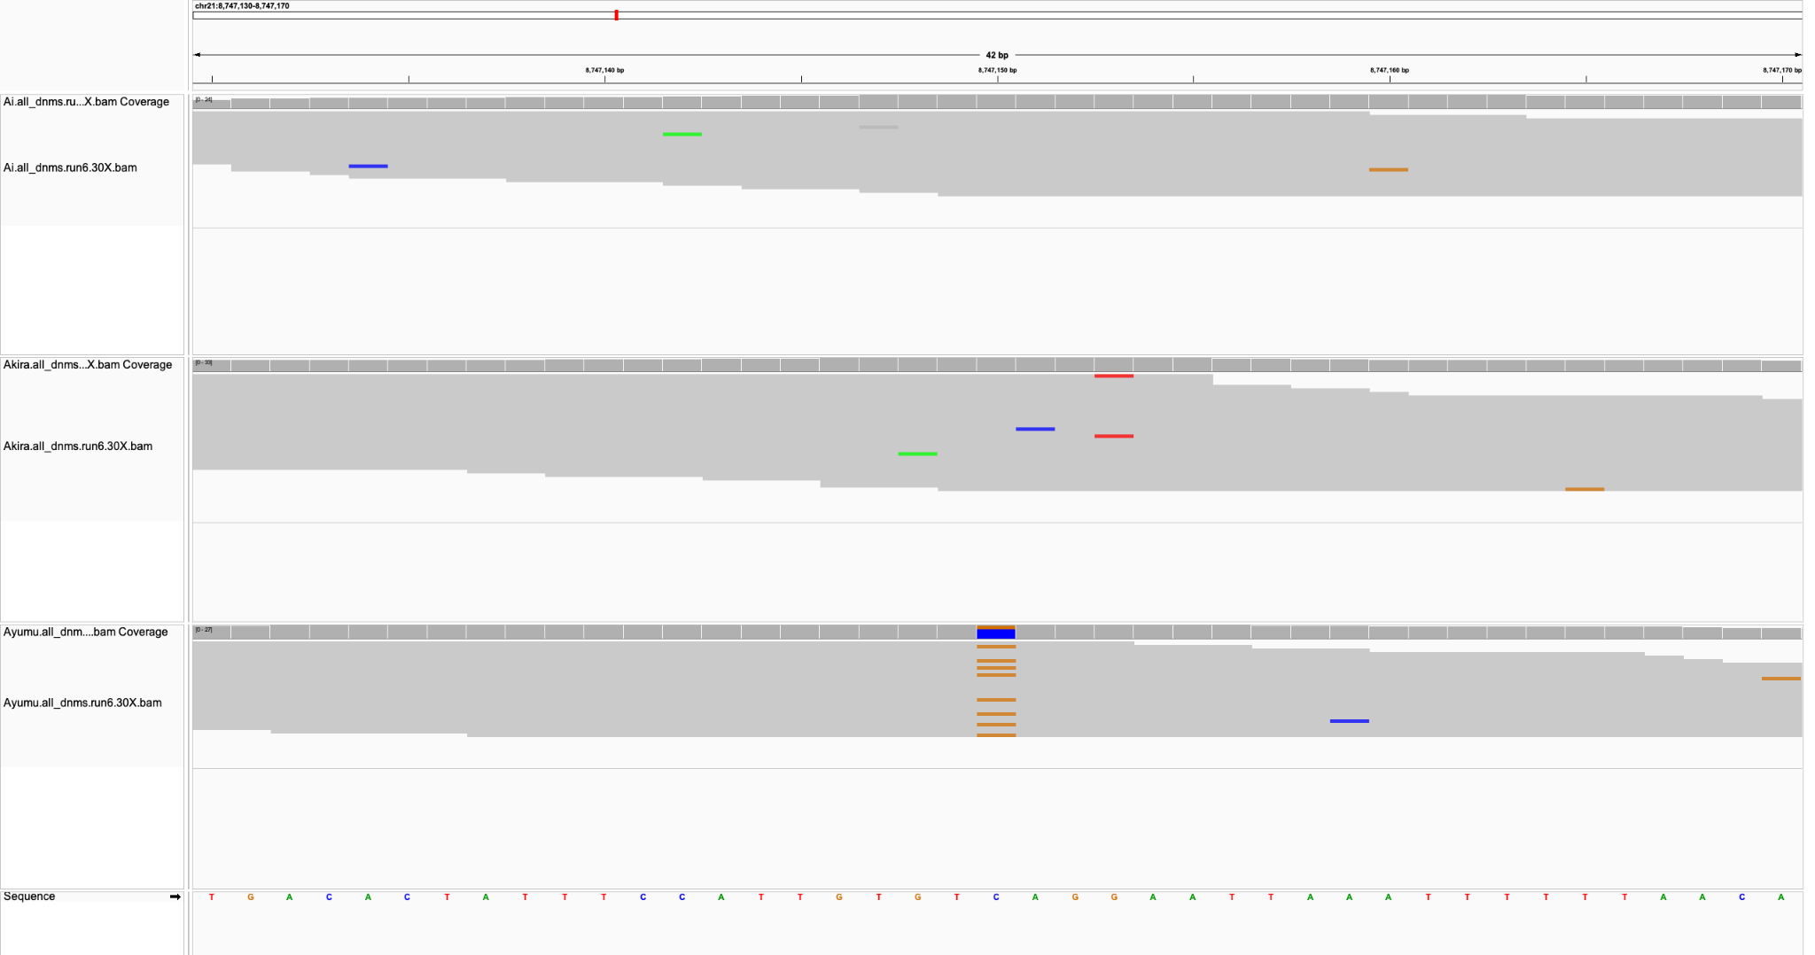
Sire
Dam
Child

Slide 52
100X DNMs - Run 6

Slide 53
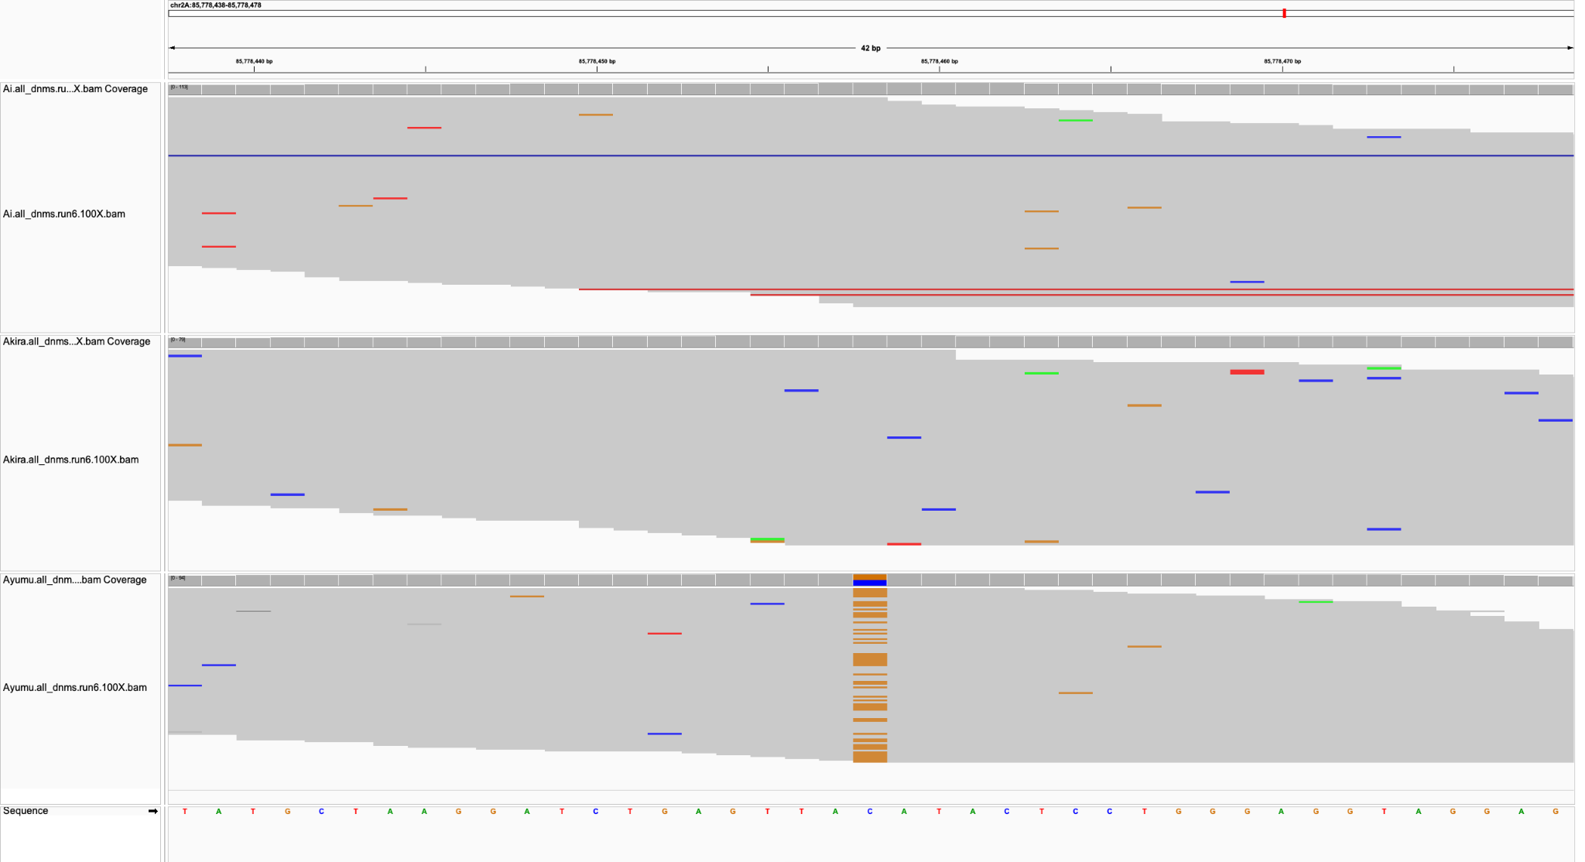
Sire
Dam
Child

Slide 54
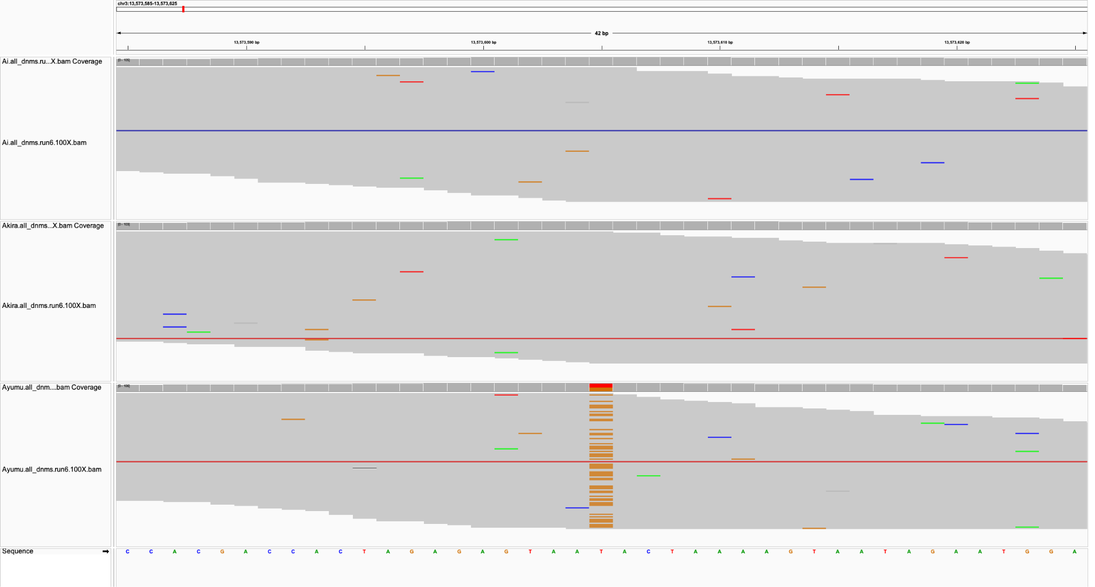
Sire
Dam
Child

Slide 55

Sire
Dam
Child

Slide 56

Sire
Dam
Child

Slide 57

Sire
Dam
Child

Slide 58

Sire
Dam
Child

Slide 59

Sire
Dam
Child

Slide 60

Sire
Dam
Child

Slide 61

Sire
Dam
Child

Slide 62

Sire
Dam
Child

Slide 63

Sire
Dam
Child

Slide 64

Sire
Dam
Child

Slide 65

Sire
Dam
Child

Slide 66

Sire
Dam
Child

Slide 67

Sire
Dam
Child

Slide 68

Sire
Dam
Child

Slide 69

Sire
Dam
Child

Slide 70

Sire
Dam
Child

Slide 71

Sire
Dam
Child

Slide 72

Sire
Dam
Child

Slide 73

Sire
Dam
Child

Slide 74

Sire
Dam
Child

Slide 75

Sire
Dam
Child

Slide 76

Sire
Dam
Child

Slide 77

Sire
Dam
Child

Slide 78

Sire
Dam
Child

Slide 79

Sire
Dam
Child

Slide 80

Sire
Dam
Child

Slide 81

Sire
Dam
Child

Slide 82

Sire
Dam
Child

Slide 83

Sire
Dam
Child

Slide 84

Sire
Dam
Child

Slide 85


Slide 86

Sire
Dam
Child

Slide 87

Sire
Dam
Child

Slide 88

Sire
Dam
Child

Slide 89

Sire
Dam
Child

Slide 90

Sire
Dam
Child

Slide 91

Sire
Dam
Child

Slide 92

Sire
Dam
Child

Slide 93

Sire
Dam
Child

Slide 94

Sire
Dam
Child

Slide 95

Sire
Dam
Child

Slide 96

Sire
Dam
Child

Slide 97

Sire
Dam
Child

Slide 98

Sire
Dam
Child

Slide 99

Sire
Dam
Child

Slide 100

Sire
Dam
Child

Slide 101

Sire
Dam
Child

Slide 102

Sire
Dam
Child

Slide 103
30X FPs - Run 6

Slide 104

Sire
Dam
Child

Slide 105

Sire
Dam
Child

Slide 106

Sire
Dam
Child

Slide 107

Sire
Dam
Child

Slide 108

Sire
Dam
Child

Slide 109

Sire
Dam
Child

Slide 110


Sire
Sire
Dam
Dam
Child
Child

Slide 111

Sire
Dam
Child

Slide 112

Sire
Dam
Child

Slide 113

Sire
Dam
Child

Slide 114

Sire
Dam
Child

Slide 115

Sire
Dam
Child

Slide 116

Sire
Dam
Child

Slide 117

Sire
Dam
Child

Slide 118

Sire
Dam
Child

Slide 119

Sire
Dam
Child

Slide 120

Sire
Dam
Child

Slide 121

Sire
Dam
Child

Slide 122

Sire
Dam
Child

Slide 123

Sire
Dam
Child

Slide 124

Sire
Dam
Child

Slide 125

Sire
Dam
Child

Slide 126

Sire
Dam
Child

Slide 127

Sire
Dam
Child

Slide 128

Sire
Dam
Child

Slide 129

Sire
Dam
Child

Slide 130

Sire
Dam
Child

Slide 131

Sire
Dam
Child

Slide 132

Sire
Dam
Child

Slide 133

Sire
Dam
Child

Slide 134

Sire
Dam
Child

Slide 135

Sire
Dam
Child

Slide 136

Sire
Dam
Child

Slide 137

Sire
Dam
Child

Slide 138

Sire
Dam
Child

Slide 139

Sire
Dam
Child

Slide 140

Sire
Dam
Child

Slide 141

Sire
Dam
Child

Slide 142

Sire
Dam
Child

Slide 143

Sire
Dam
Child

Slide 144

Sire
Dam
Child

Slide 145

Sire
Dam
Child

Slide 146

Sire
Dam
Child

Slide 147

Sire
Dam
Child

Slide 148

Sire
Dam
Child

Slide 149

Sire
Dam
Child

Slide 150

Sire
Dam
Child

Slide 151

Sire
Dam
Child

Slide 152

Sire
Dam
Child

Slide 153

Sire
Dam
Child

Slide 154

Sire
Dam
Child

Slide 155

Sire
Dam
Child

Slide 156

Sire
Dam
Child

Slide 157

Sire
Dam
Child

Slide 158

Sire
Dam
Child

Slide 159

Sire
Dam
Child

Slide 160

Sire
Dam
Child

Slide 161

Sire
Dam
Child

Slide 162

Sire
Dam
Child

Slide 163

Sire
Dam
Child

Slide 164

Sire
Dam
Child

Slide 165

Sire
Dam
Child

Slide 166

Sire
Dam
Child

Slide 167

Sire
Dam
Child

Slide 168

Sire
Dam
Child

Slide 169

Sire
Dam
Child

Slide 170

Sire
Dam
Child

Slide 171

Sire
Dam
Child

Slide 172

Sire
Dam
Child

Slide 173

Sire
Dam
Child

Slide 174

Sire
Dam
Child

Slide 175

Sire
Dam
Child

Slide 176

Sire
Dam
Child

Slide 177

Sire
Dam
Child

Slide 178

Sire
Dam
Child

Slide 179

Sire
Dam
Child

Slide 180

Sire
Dam
Child

Slide 181

Sire
Dam
Child

Slide 182

Sire
Dam
Child

Slide 183

Sire
Dam
Child

Slide 184

Sire
Dam
Child

Slide 185

Sire
Dam
Child

Slide 186

Sire
Dam
Child

Slide 187

Sire
Dam
Child

Slide 188

Sire
Dam
Child

Slide 189

Sire
Dam
Child

Slide 190

Sire
Dam
Child

Slide 191

Sire
Dam
Child

Slide 192

Sire
Dam
Child

Slide 193

Sire
Dam
Child

Slide 194

Sire
Dam
Child

Slide 195

Sire
Dam
Child

Slide 196

Sire
Dam
Child

Slide 197

Sire
Dam
Child

Slide 198

Sire
Dam
Child

Slide 199

Sire
Dam
Child

Slide 200


Sire
Sire
Dam
Dam
Child
Child

Slide 201

Sire
Dam
Child

Slide 202

Sire
Dam
Child

Slide 203
100X FPs - Run 6

Slide 204

Sire
Dam
Child

Slide 205

Sire
Dam
Child

Slide 206

Sire
Dam
Child

Slide 207

Sire
Dam
Child

